Slide 1
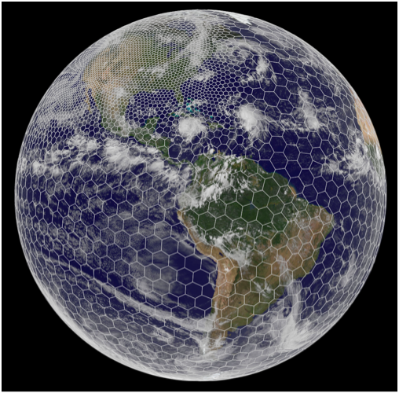
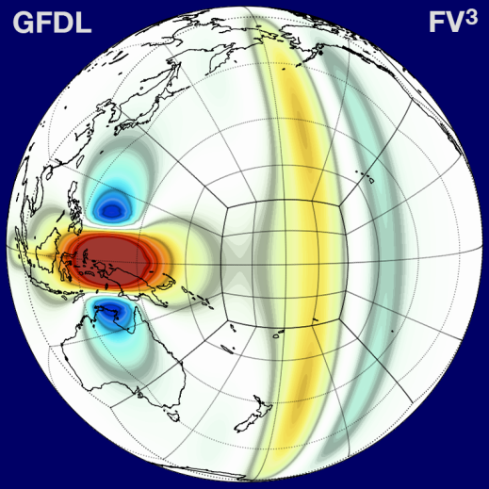
Next Generation Global Prediction System
(NGGPS)
Phase 2 Atmospheric Dynamic Core Testing and Evaluation
NCAR MPAS
Presentation For NCEP EMC
Fred Toepfer/Tim Schneider, Vijay Tallapragada, Jeff Whitaker, and Steve Warren
& the Dynamic Core Test Group
July 19, 2016

Slide 2
Outline
NGGPS Goals and Objectives
NGGPS Strategy
Dynamic Core Testing Process and Timelines
Dynamic Core Assessment (Phase 2)
Dynamic Core Selection Recommendation

Slide 3
NGGPS Goals and Objectives¹
Design/Develop/Implement NGGPS global atmospheric prediction model
  Non-hydrostatic scalable dynamics
  Accelerated physics improvement profile
Improve data assimilation
Position NWS for next generation high performance computing
World’s Best Global Forecast Guidance
1 – From NWS Budget Initiative proposal to OMB

Slide 4
Rationale for Replacing Global Spectral Model (GSM)
Continued GFS operational performance improvements will require non-hydrostatic resolutions
Hydrostatic GSM at end-of-life
  Does not scale well
Next-Generation computing paradigm will require scaling across potentially 100,000’s processors or more
Semi-Lagrangian spectral cores have significantly poorer effective resolution than competing cores, for same nominal resolution
Parallel efforts initiated at UKMO and ECMWF
Notes:
- Slide 26 (KE spectra) supports rationale that semi-lagrangian spectral cores have significantly poorer effective resolution than competing cores, for same nominal resolution

Slide 5
NGGPS Global Atmospheric Model Technical Strategy
Reduce implementation time and risk by separating dynamic core and model physics
Identify and implement optimal core for global weather forecast applications
  Highly scalable
  Non-hydrostatic
Accelerate evolution of model physics
  Develop/Implement Common Community Physics Package (CCPP)
    Based on current GFS physics package
    Integration of best of other existing physics packages
    Scale aware
Employ Global Modeling Test Bed (GMTB) to encourage and facilitate community interaction

Slide 6
NGGPS Atmospheric Model Phased Implementation Approach
Phase 1 (FY15) – Identify Qualified Dynamic Cores
  Evaluate technical performance
    Scalability
    Integration of scheme stability and characteristics
Phase 2 (FY16) – Select Candidate Dynamic Core
  Integrate with operational GFS Physics/CCPP
  Evaluate meteorological performance
Phase 3 (FY17-19) – Dynamic Core Integration and Implementation
  Implement candidate dynamic core in NEMS
  Implement Common Community Physics Package
  Implement data assimilation (4DEnVar with 4D incremental analysis update and stochastic physics)
  Implement community model environment

Slide 7
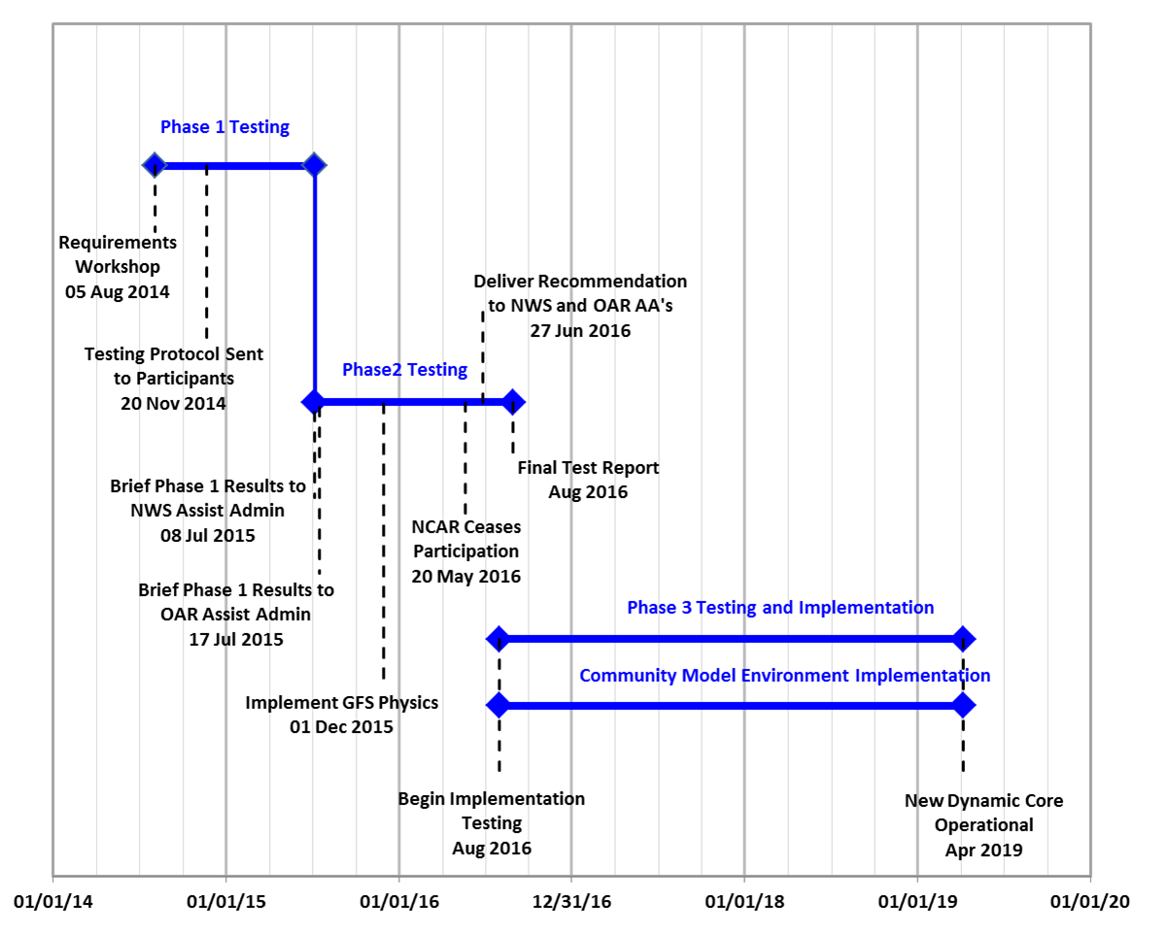
Dynamic Core
Testing and Implementation Timeline
19 Jul 2016

Slide 8
Phase 2 Reporting Schedule
Brief UMAC (22 June 2016) - Complete
Deliver DTG Recommendation
(27 June 2016) - Complete
Brief NOAA Administrator and Chief Scientist (26 July 2016)
DTG Report Prepared (Early August 2016)
Final Report Delivered (Late August 2016)

Slide 9
Testing and Evaluation Summary

Slide 10
NGGPS Dycore Test Group (DTG)
Membership
Ming Ji, Chair
  Dir., Office of Sci. Tech. Integ.
Fred Toepfer
  NGGPS Program Manager
Tim Schneider
  Acting NGGPS Program Manager
Bob Gall
  Independent Consultant
Ricky Rood
  Independent Consultant
John Thuburn
  Independent Consultant
Melinda Peng/Jim Doyle
  Navy/NRL Monterey
Ram Ramaswamy/SJ Lin
  GFDL
Hendrik Tolman/Vijay Tallapragada
  NCEP/EMC
Chris Davis/Bill Skamarock*
  NCAR/MMM
Kevin Kelleher/Stan Benjamin
  ESRL/GSD
Jeff Whitaker
  NGGPS Test Manager
John Michalakes
  Chair, Advanced Computing Evaluation Committee
* NCAR ceased participation and withdrew from DTG on 20 May 2016

Slide 11
New Dynamic Core
Candidate Models
Phase 1 Candidate Dynamic Cores*:
* Built upon HIWPP Non-hydrostatic Model Evaluation
Non-hydrostatic Global Spectral Model (GSM) - EMC
Global Non-hydrostatic Mesoscale Model (NMM & NMM-UJ) - EMC
Model for Prediction Across Scales (MPAS) - NCAR
Non-hydrostatic Icosohedral Model (NIM) – ESRL
Navy Environmental Prediction System Using the NUMA Core (NEPTUNE) – Navy
Finite Volume Model version3 (FV3) – GFDL
FV3 and MPAS selected to advance to Phase 2

Slide 12
Phase 2 Test Plan Development Timeline
Test Plan Developed by DTG between June and December 2015
  Testing Criteria Finalized by DTG at Face-to-Face Meeting in September 2015
  Initial Test Plan Developed by November 2015 (including AVEC Test Plan)
Test Plan Approved by DTG in January 2016

Slide 13
NGGPS Phase 2 Test Plan
# | Evaluation Criteria
1 | Plan for relaxing shallow atmosphere approximation (deep atmosphere dynamics)*
2 | Accurate conservation of mass, tracers, entropy, and energy
3 | Robust model solutions under a wide range of realistic atmospheric initial conditions using a common (GFS) physics package
4 | Computational performance with GFS physics
5 | Demonstration of variable resolution and/or nesting capabilities, including supercell tests and physically realistic simulations of convection in the high-resolution region
6 | Stable, conservative long integrations with realistic climate statistics
7 | Code adaptable to NEMS/ESMF*
8 | Detailed dycore documentation, including documentation of vertical grid, numerical filters, time-integration scheme and variable resolution and/or nesting capabilities*
9 | Evaluation of performance in cycled data assimilation
10 | Implementation Plan (including costs)*
* Results in back-up detailed Phase 2 test results
Notes:
Here’s a list of the ten testing and evaluation criteria included in the test plan. 1,7,8 and 10 involve self-reporting, the rest involve running model tests.

Slide 14
Summary of Phase 2 Test Results
Testing yielded sufficient information to evaluate both dynamic cores and produce a low risk recommendation without compromising performance or skill
Summary of results:
  Computationally, FV3 is more than twice as fast as MPAS with equivalent resolution
  Full forecast experiments with GFS initial conditions and GFS physics showed significant differences between FV3 and MPAS, FV3 almost equivalent to GFS (some stability issues with MPAS forecasts)
  FV3 performs comparable to the GFS in cycled data assimilation test (without tuning, at reduced resolution), MPAS performance inferior to GFS
  Effective resolution for both dynamic cores is found to be similar, and higher than GFS
  High-resolution idealized and real-data simulations show qualitatively similar results in simulations of explicit moist convection
  Cost to implement FV3 is significantly less than MPAS in terms of manpower and computational resources
Notes:
TC test, MPAS not able to finish conservation tests out to 20 days; three of 75 full forecasts failed with original time step, MPAS had to rerun them with reduced timestep. These issues were not a major factor in the evaluation decision.

Slide 15
#2: Conservation Tests
DCMIP-2012 baroclinic wave idealized test, dry and moist (4.1 and 4.2) run at 13 km resolution. Simple moist physics (large-scale condensation only) included.
Conservation of total energy, entropy and dry mass measured
Extra advected tracer added, initialized with θ_{e} (difference between advected and diagnosed θ_{e} measured)
’Grid imprinting’ (signal of truncation errors at cube corners and pentagons of icosahedral grid) assessed
Notes:
Criteria #2 (accurate conservation of energy, entropy and mass) was evaluated using an idealized baroclinic wave test from the 2012 Dynamical Core Intercomparison Project. The test was run at 13 km resolution (the current nominal GFS resolution) with and without simple moist physics.
Won’t discuss grid imprinting here other than to say that at this resolution, the imprint of the grid on the solution can be seen in both models if you look hard enough, but it is extremely small (several orders of magnitude less that the variability of interest).
I also won’t discuss the advected tracer test, but it is included in the backup slides.

Slide 16
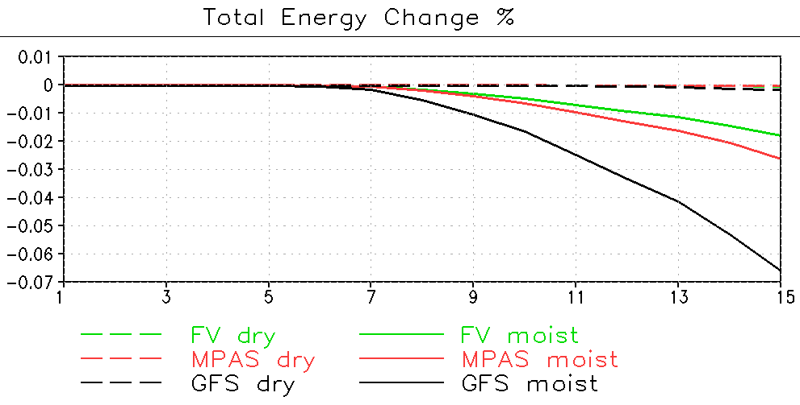
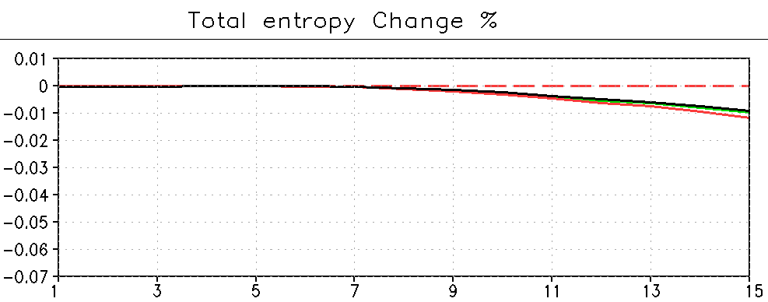
#2: Conservation Tests
Change in Total Energy and Entropy
Change in total energy (top) and entropy (bottom) as a percent change from the initial value. Note very tiny range on y axis.
Energy loss nearly zero in dry case, FV3 and MPAS lose less energy than GFS in moist case.
Energy loss in moist case for FV3 and MPAS is consistent with the energy removed along with condensate. Entropy changes for moist case are very small, and consistent with thermodynamic approximations made in entropy definition.
Dry mass (not shown) is conserved exactly in both FV3 and MPAS, GFS gains 0.05 hPa during integration.
% change
% change
Notes:
Test specification was to run out to 20 days. FV3 submitted results out to 20 days, MPAS only submitted results to day 15 since integration failed during day 16. Reason for failure not identified, could be related to convective instability in tropics and associated large vertical velocities there. A GFS baseline was also run.
In this and all subsequent plots, FV is green, MPAS red and GFS black.
Changes in energy and entropy nearly zero for the dry case for all 3 models. For the moist case, energy loss for FV3 and MPAS was less than GFS, and consistent with the fact that the physics does not exactly conserve energy (energy is not removed along with condensate). Entropy changes for the moist case are small in all 3 models, and consistent with small approximations made in the definition of moist entropy.
Dry mass is exactly conserved in FV3 and MPAS, but not in GFS (since the GFS does not account for changes in the total mass due to precipitation).

Slide 17
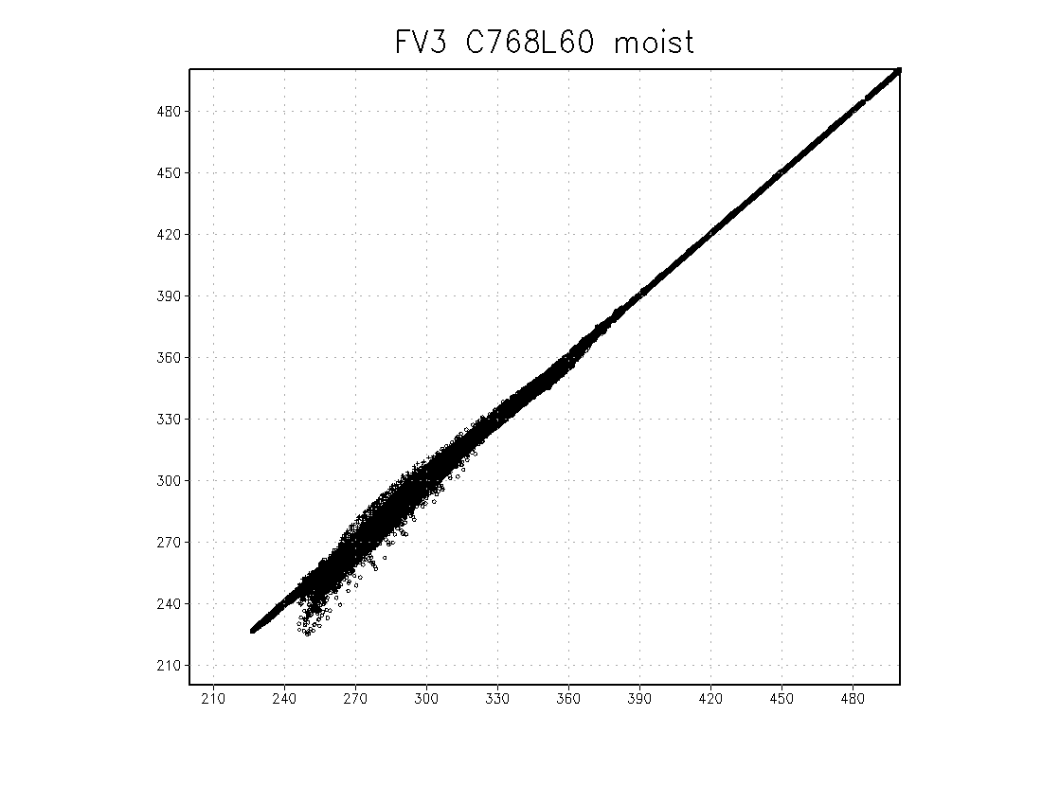


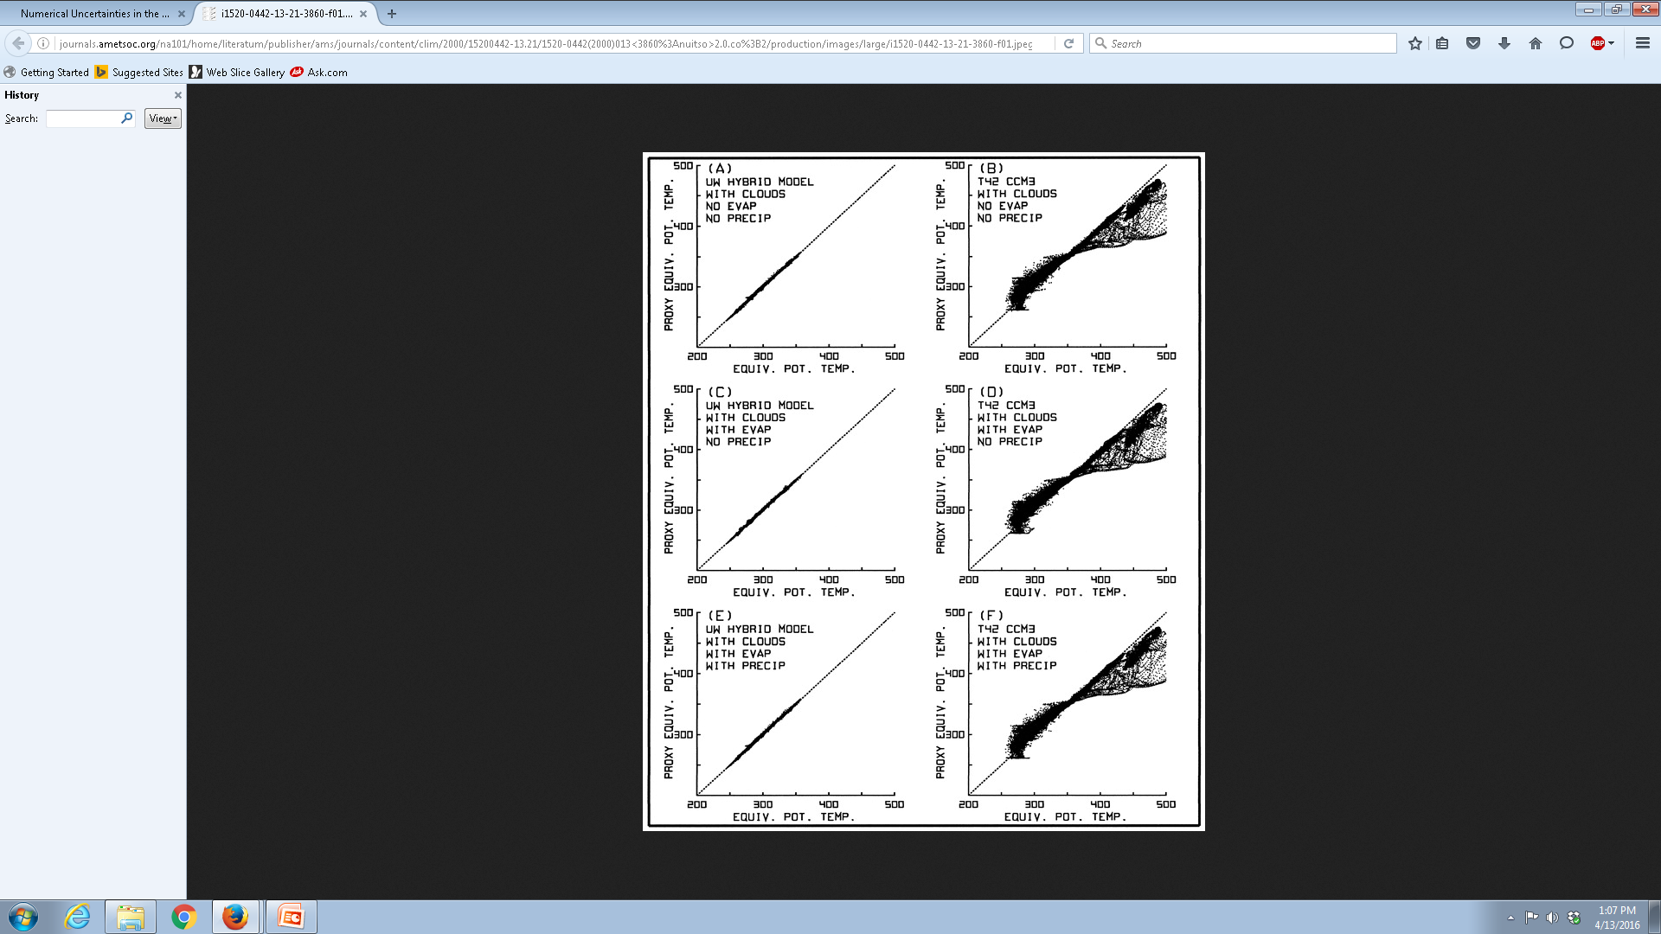
#2: Conservation Test: RMS Difference Between Advected Tracer and Dynamical Field (Day 15)
FV3 RMS=0.232
MPAS RMS=0.126
GFS RMS=0.202
Proxy Θe
Proxy Θe
Proxy Θe
Θe
Θe
Θe
Scatterplots of Θe and proxy Θe (tracer) at day 15 for the moist baroclinic wave (DCMIP test 4.2). Compare with Figure 1 of Johnson et al. 2000.
FV3, GFS and MPAS are similar, much better than CCM3 result from Johnson et al.
UW RMS=0.69
CCM3 RMS=10.6
Day-10 scatter plots from Johnson et al. 2000

Slide 18
#3: Retrospective 13 km 10-d Forecasts with GFS physics
GFS physics package (provided by EMC) implemented in both models by FV3 and MPAS development teams
74 retrospective 10-d forecasts run at 13 km resolution with 64 vertical levels, initialized from GFS analyses every 5th day for calendar year 2015
Validated using NCEP verification suite, compared to operational GFS forecasts; statistics available at:
  http://www.emc.ncep.noaa.gov/gmb/wx24fy/nggps/web/
Goals:
  Assess ‘robustness’ over a wide-range of atmospheric flow conditions
  Assess work required to replace spectral dycore in operational GFS
Notes:
For criteria #3, GFS physics was implemented in both models (with the help of EMC). 74 retro forecasts were run out to 10 days initialized from operational analyses, validated with the NCEP verification suite. The goal of this test was to assess the robustness of the dycores with physics, orography and initial conditions from an operational environment, over a wide range of conditions. In addition, EMC used this test to estimate the cost to replace the spectral dycore in the operational GFS.

Slide 19
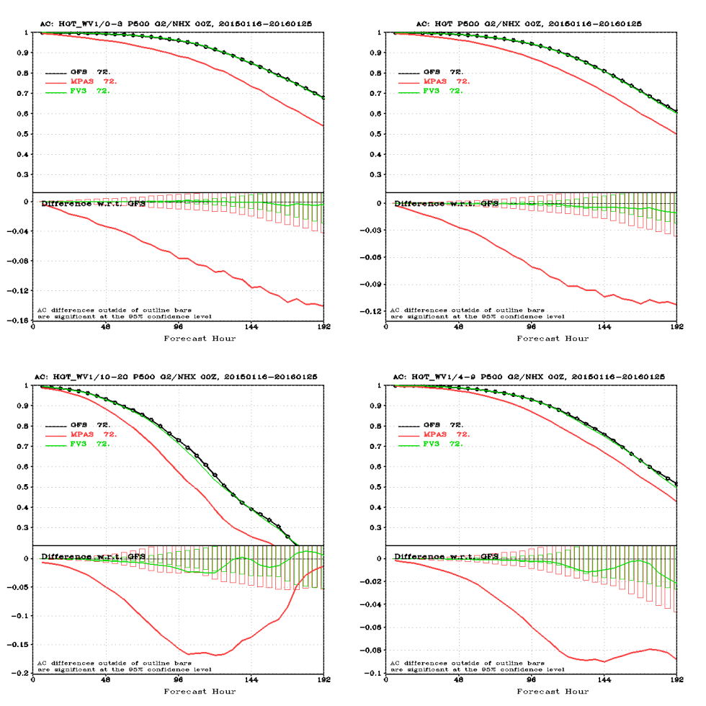
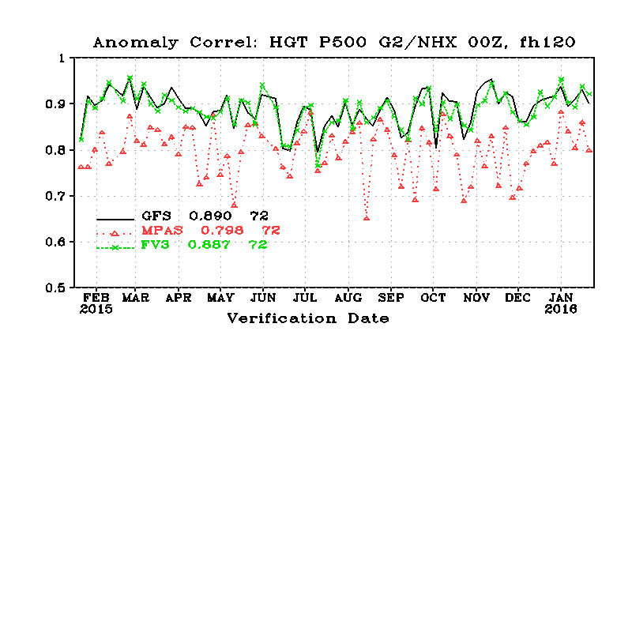
#3: Retrospective 13 km Forecast Skill
FV3 forecast skill matches the GFS using GFS ICs and GFS Physics
Notes:
This plot shows the 500 hPa anomaly correlation skill at day 5 (on the left) and a a function of forecast lead time on the right. Using the GFS physics package “out of the box” with no tuning, the FV3 was able to match the GFS performance at the current operational nominal resolution of 13km MPAS performance was substantially less.
Robustness: MPAS failed for 6 out of the 74 runs; had to be run with a reduced timestep.
Cost/Work required to replace spectral dycore: FV3 significantly lower cost, work required to replace spectral dycore in Q1FY19.

Slide 20
#4: Performance Benchmark: Methodology
GFS physics runs with double (64b) floating point precision
Configurations same as for retro forecasts
3 nominal resolutions: 15 km, 13 km, 11 km; 63 levels (so differences in effective resolution could be accounted for). Benchmark parameters agreed to by NCAR and GFDL
Dedicated access to Cori system at NERSC (similar to Luna/Surge); runs conducted on otherwise empty machine
Metric: Number of processors required to achieve 8.5 minutes per day simulation rate
Multiple runs varying numbers of processors to straddle 8.5 min/day simulation rate
Also tested were:
  Efficiency of mesh refinement strategies (using configuration for criteria #5)
  Performance with 15 and 30 extra tracers
Notes:
Criteria #4 is computational performance. A sub-committee of the DTG, headed by John Michalakes and including reps from both modeling groups, was formed to design and execute a series of benchmarks. All members agreed to the configuration and design of the benchmarks. GFS physics was used, with the same model configuration as was used in the retro forecasts. The ability of two different models to resolve a certain feature may not necessarily be reflected by differences in the size of their grid cells – it can also be affected by the numerical discretization and diffusion. To account for this, benchmarks were run at three different resolutions, bracketing the nominal grid spacing of the operational GFS. The idea is that differences in effective resolution could then be accounted for by interpolating the timings between these three data points.
The metric used was the number of processors needed to achieve a certain throughput (8.5 mins per simulated day). The runs were done on the Cori system at DOE/NERSC, which is similar to the new NCEP machine (Luna). NERSC graciously provided dedicated access to their machine, so no other jobs were running at the time.
In addition to the core performance test, the efficiency of the tracer advection algorithms and the mesh refinement strategies used by each dycore were also tested.

Slide 21
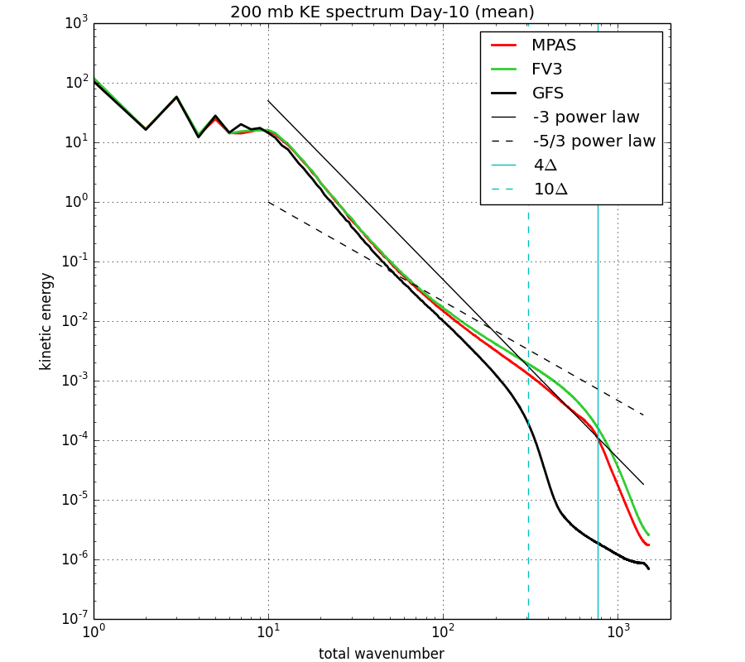
#4 Performance Benchmark: KE Spectra (Effective Resolution)
FV3, MPAS and GFS 10-d forecasts at 13km nominal resolution.
Effective resolution of MPAS and FV3 similar, much better than GFS.
Notes:
Assessment of effective resolution needed for apples-apples performance benchmark calculation (performance benchmark run at 11,13 and 15 km). An established metric for evaluating effective resolution is to use energy spectra, and look for the point at which the spectra become much steeper than a reference power law (based on observations and theory). This is the scale at which numerical diffusion begins to dominate.
Shown on this graph are the KE spectral for the three models, and two reference power law spectra (-3, which is expected to occur on synoptic and larger spatial scales where turbulence is quasi 2D) and -5/3, which is expected to occur on mesoscale and short scales where turbulence is 3D. Note that the spectra for both MPAS and FV3 start to fall off at roughly the same scale, about 4dx. The GFS spectra falls off close to 10dx, and exhibits no shallowing in the mesoscale region associated with the transition to 3d turbulence.
From this we conclude that there is no detectable difference between the effective resolution of MPAS and FV3, and both are have significantly higher resolution than the current operational GFS, using the same nominal grid spacing. Therefore, no rescaling of the benchmark results to match the effective resolution of FV3 and MPAS is necessary.
Wavenumber where slope becomes steep is a measure of effective resolution (scale at which diffusion starts to dominate).
Effective resolution of MPAS and FV3 similar (close to 3dx, T511), much better than GFS (close to 6dx, T254).
No ’shallowing’ of spectra in mesoscale evident in GFS, evident in both MPAS and FV3.
Effective resolution of MPAS and FV3 similar (close to 3dx, T511), much better than GFS (close to 6dx, T254).
No ’shallowing’ of spectra in mesoscale evident in GFS, evident in both MPAS and FV3.

Slide 22
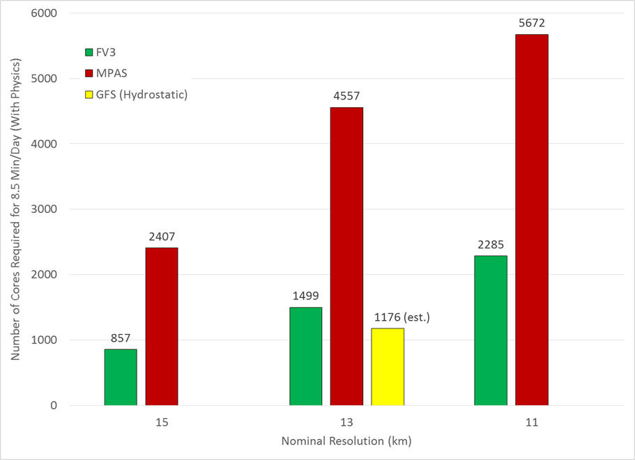
#4: Performance Benchmark Results (J. Michalakes)
Notes:
Here are the results of the core performance test. Again, the metric is the number of cores needed to achieve 8.5 mins/day simulation rate.
FV3 requires 3x fewer processor cores to achieve 8.5 mins per day at 13 km resolution.
FV3 at 11 km resolution requires fewer cores than MPAS at 15 km resolution.
FV3 at 13 km resolution requires about 25% more cores than GFS at same nominal resolution (although effective resolution of FV3 is significantly higher than the GFS).
Performance with 15-30 additional tracers, and refinement efficiency also measured (see backup slides).

Slide 23
#5: Demonstration of Variable Resolution
and Nesting Capabilities
Includes simulations of convection in the high-resolution region, and includes supercell and tropical cyclone (TC) idealized tests
Real-data forecasts:
  Mesh varies from 13 km to 3 km over CONUS
  GFS physics with deep convection disabled
  Initial conditions for 2013051800 (Moore tornado) and 2012102418 (Hurricane Sandy), forecasts run to 10 days
  MPAS used a non-uniform mesh, FV3 used a combination of a global stretched grid and a nest
Idealized tests:
  Since cases chosen involve severe convection and tropical cyclones, companion idealized tests used to isolate impact of dynamical core on simulations of these phenomena (with highly idealized physics and no mesh refinement)
  Supercell test (DCMIP-2016, reduced sphere 0.51/2/4 km) also run in Phase I, but not with identical diffusion settings
  TC test from DCMIP-2012 (full sphere, 13 km)
Notes:
Criteria #5 involves demonstration of variable resolution and/or nesting capabilities, and includes an assessment of the ability of the models to simulate explicit moist convection in severe storm continental environments and tropical cyclones. As part of the evaluation, real data forecasts run for two cases, the Moore tornado and Hurricane Sandy cases. MPAS used a non-uniform mesh, FV3 a combination of stretched grid and a nest.
Two idealized tests were used to supplement the real-data forecast tests, an idealized supercell and tropical cyclone test. These tests were used to isolate the impact of the dynamical core on the simulation of these phenomena, apart from the impacts of the mesh refinement strategy).

Slide 24
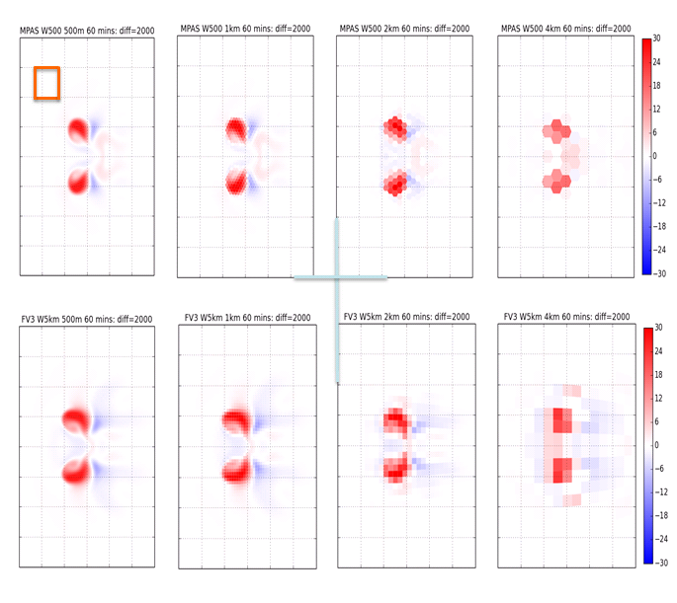
#5: Idealized Supercell Test
500 hPa Vertical Velocity (m/s), All Resolutions
MPAS 500 m
MPAS 1 km
MPAS 2 km
MPAS 4 km
10x10 km
FV3 500 m
FV3 1 km
FV3 2 km
FV3 4 km
Notes:
First, the idealized supercell test. The supercell test was designed to compare the ability of each dycore to simulate explicit moist convection with idealized physics (Kessler). The test is run on a reduced radius sphere with no rotation, and convection is initiated with a warm bubble in shear with an unstable profile. The horizontal diffusion coefficient is identical in both models, no vertical diffusion and no PBL.
Diffusion coefficient chosen to produce ‘converged’ solution at 0.5 km (solutions at 0.5/1km are very similar). This allows the behavior to be examined as resolution is degraded. The solution is shown for four different resolutions at 60 mins, at which point the updraft has split into two distinct cells. The indivdual grid cell polygons are filled in the plots, no interpolation is done.
Both simulations produce two cells of upward motion. The shapes of the cells differ, notably; the cells in MPAS are more round than in FV3. The FV3 cells are elongated in the west-east direction. For both the 0.5 km and the 1.0 km resolutions it is reasonable to say that the cells are “resolved, and the size of the cell is ~ 10 km. The 0.5 km (1.0 km) resolution is ~ 20 delta x (10 delta x) in the plot-grid boxes used on the graph. As the resolution is degraded to 2.0 km (5 delta x), the underlying grid structure of the two dynamical cores emerges. Both dynamical cores maintain some characteristics of the higher resolution solutions. At the coarsest resolution, 4km (~ 2.5.delta x) both simulations are dominated by the underlying grid structure, and the qualitative agreement with higher resolution simulations is weakening. At this resolution the coherent representations of updrafts and downdrafts is missing. The features are unresolved, or at best, crudely resolved.
Conclusion: no major difference between dycores in simulation of moist convection in this idealized setting..

Slide 25
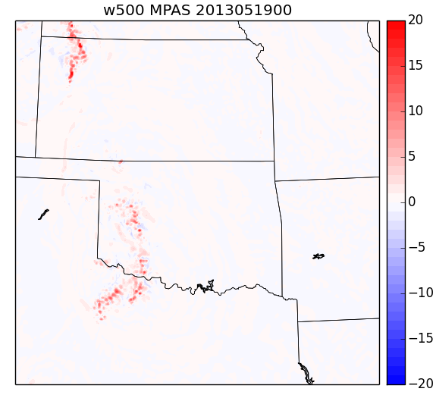
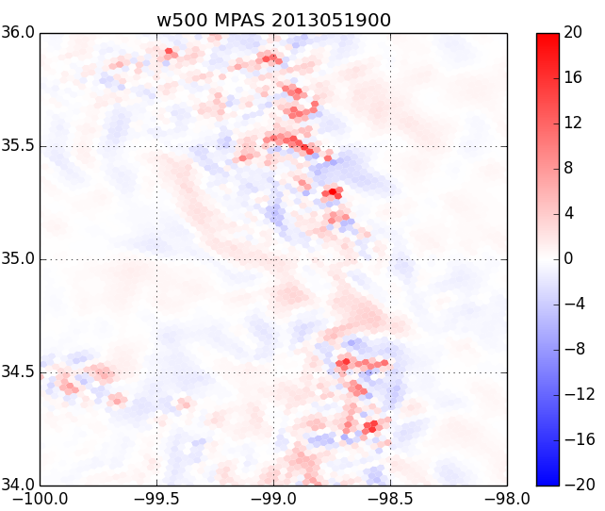
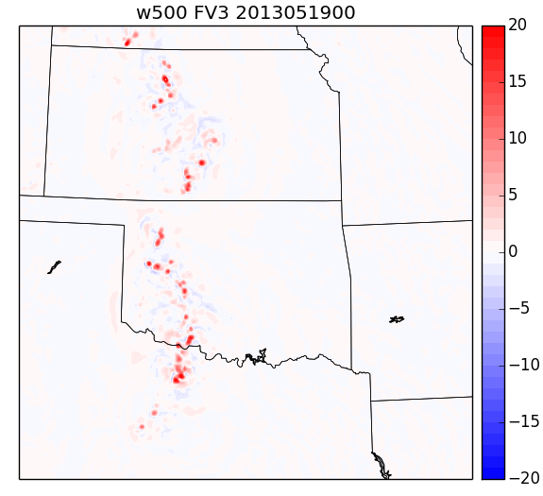
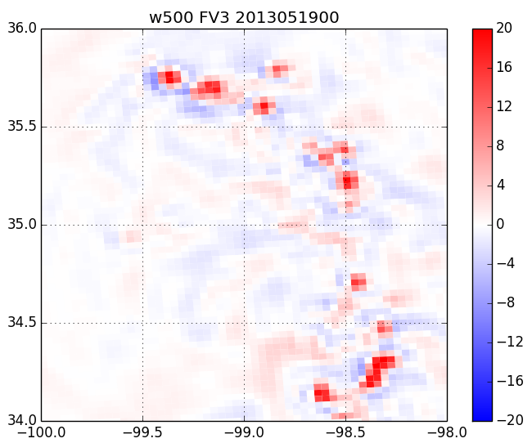
#5: Variable Resolution Tests
Moore Tornado Case – 24h Fcst Valid 00UTC May 19
500hPa Vertical Velocity (m/s)
Notes:
Moving on to the real data cases – first the Moore tornado case. Moore tornado was on 21st (day 3), focus here on day 1. Both models produced convection in west central OK. Severe convection did occur there, with large hail and damaging winds (but no tornados). Zooming in on that region, you can see that the model updrafts are occurring near the grid scale
Scale of updrafts slightly smaller in MPAS. We think primarily related to grid structure (FV3 grid boxes are larger in this part of the domain, see next slide).
Supercell test run with same model configuration (but identical resolution mesh) does not show significant differences in updraft scales.

Slide 26
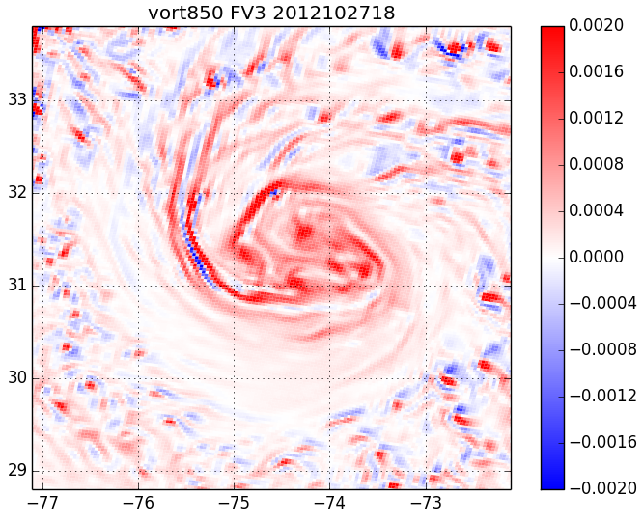
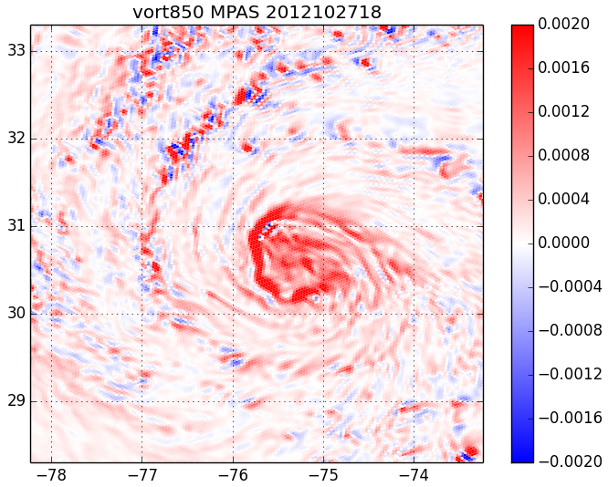
#5: Variable Resolution Tests: Hurricane Sandy Case: 72h Fcst Valid 18 UTC Oct 27
850 hPa Vertical Vorticity (s⁻¹)
Notes:
Moving on to the Hurricane Sandy case, the 850 hPa vorticity field at day 3 of the forecast is shown. Note domain is storm centered, and slightly different for each model (MPAS storm about 1 degree farther east and south).
Vorticity features smaller scale in MPAS – again likely related to the way the high-resolution region is defined (MPAS grid boxes are smaller).
We acknowledge that GFS physics is not designed for accurate simulations of severe convection, but it does well enough to provide a controlled environment that can be used to evaluate the impact of dycore numerics.
Small differences seen in hurricane and severe convection simulations likely related more to mesh configuration than dycore numerics. No fundamental differences between dycores evident.

Slide 27
#6: Stable, Conservative Long Integrations with Realistic Climate Statistics
90 days runs at reduced resolution (~50 km), from GFS 00UTC Sep 1 2015 analysis, with surface conditions updated every 6 hours
Assessment will include:
  90-day mean statistics
  Time series of dry mass, energy
  Detection of ‘grid imprint’
Notes:
Criteria #6 was designed to assess dycore suitability for seasonal to interannual forecasting. To that end, we are conducting…
Ultimately, the assessment will include evaluation of 90 day mean stats, time series of dry mass energy, and the detection of ‘grid imprint’.

Slide 28
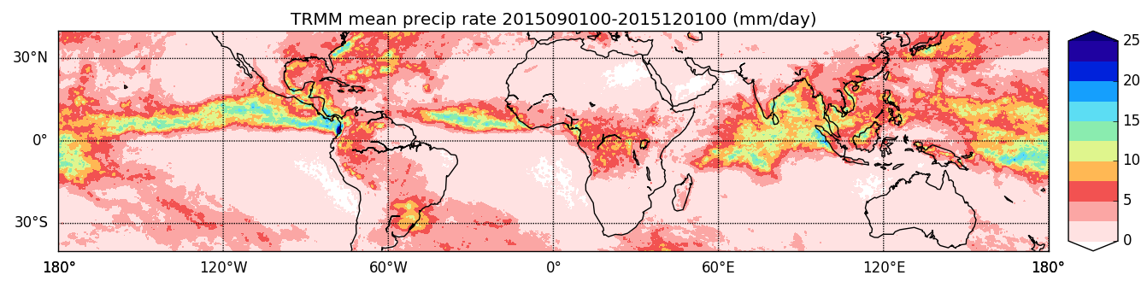
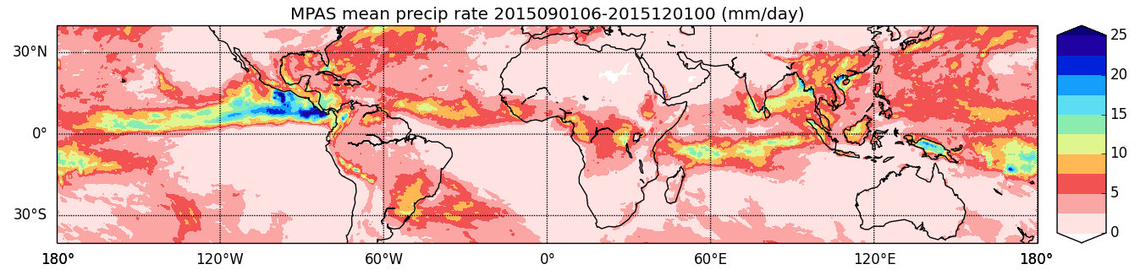
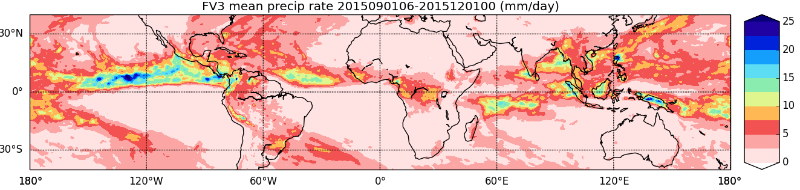
#6: Stable, Conservative Long Integrations with Realistic Climate Statistics
Day 0-90 Mean, IC 2015090100, ~50 km Resolution
TRMM
MPAS
FV3
Notes:
90 day mean precip, compared to TRMM estimates. Basic measure of the tropical climate under El Nino conditions.
Both MPAS and FV3 produce a reasonable simulation of the precip field in the tropics. Enhancement of precip in EPAC overdone in both models (but less so in MPAS), likely a GFS physics issue. Global mean (50N-50S) is 3.26 mm/day for FV3, 3.33 mm/day for MPAS, 2.89 for TRMM. Analysis is very preliminary, but no fundamental problems exposed in either dycore so far that would hamper application to SI forecasting.

Slide 29
#9: Evaluation of Performance in Cycled Data Assimilation (DA)
Both models interfaced to operational 4D ensemble-variational DA system
Due to time and HPC constraints, tests run at reduced resolution (~50 km)
80 member ensemble, cycle started at 2015090100 (In progress, results are preliminary)
Differences with operational configuration:
  No high-resolution control analysis
  No static background error component (full ensemble used to maximize feedback between dycore and DA)
  No digital filter or tangent-linear balance constraint
  No stochastic physics in ensemble (multiplicative inflation increased to compensate)
Baseline GFS experiment at T382 resolution for reference
Assessing:
  Work required to replace spectral dycore in GDAS
  Whether issues arise that may not be evident when models initialized from ‘foreign’ analysis
Notes:
The cycling DA test was included to assess both the work required to replace the spectral dycore in the GDAS, and to find out if any issues arise that did not show up when the models were initialized from the GFS analysis.

Slide 30
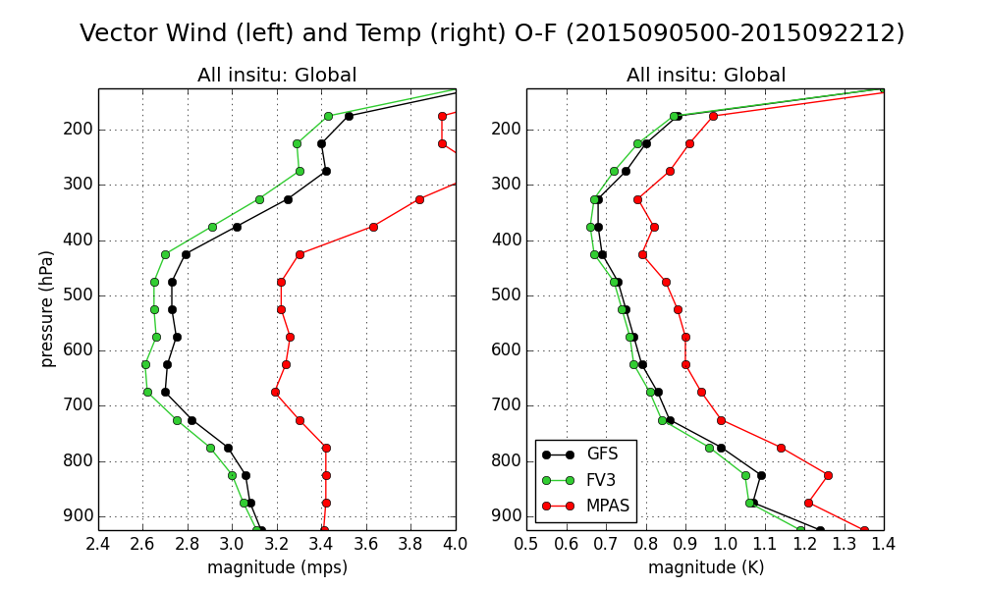
#9: DA Cycling: RMS Fit of First-Guess to
All In-situ Observations
(in progress, preliminary)
Notes:
- FV3 actually performs better than GFS (consistent with higher effective resolution) – indicating that forecast skill should improve when initialized from it’s own cycling DA system.
- Differences between FV3 and MPAS are consistent with differences in forecast skill in 10-d retro forecast tests.

Slide 31








NGGPS Phase 2 Testing
Dycore Technical Assessment
Technical Readiness for Operations | MPAS | FV3 | Comments
- Computational Performance with GFS Physics |  |  | FV3 Faster at Equal Nominal Resolution
- Cycled Data Assimilation |  |  | FV3 (MPAS) performance similar (inferior) to GFS
- Full Experiments w/ GFS Initial Cond’s/Physics |  |  | FV3 as Accurate as GFS; MPAS Significantly Less
- Variable Resolution Testing (Moore Tornado, Hurricane Sandy) |  |  | Scale-aware Advanced Physics Needed for Either Dycore
- Deep Atmosphere Dynamics Plan/Implementation | / | / | Both Suitable
- Conservation |  |  | MPAS Less Stable in Tropics
- Supercell Test |  |  | Both Similar
- TC Simulation |  |  | Issues with MPAS TC Structure, Likely Related to Simple Physics Configuration
- Long Integrations with Realistic Climate Statistics |  |  | In Progress/Preliminary
- Next Generation Computing Suitability/Readiness
- NEMS/ESMF Readiness | N/A |  | MPAS Incomplete
Technical Readiness: (Extensive Development Required)
(Modest Level of Development Required)
(Little Additional Development Required)
Notes:
- MPAS TC structures in real-data forecasts look fine. Issues noted in idealized testing.

Slide 32
NGGPS Phase 2 Testing
Dycore Cost Assessment
 | MPAS | FV3 | Comments
Initial Implementation Into Global Forecast System | $ | $
- Personnel | $ | $
- HPC | $ | $
Implementation into CFS/GEFS | $ | $
- Personnel | $ | $
- HPC | $ | $
DA | $ | $
WAM | $ | $
Cost: Low: $ (<1M) Moderate: $ (1-5M) High: $ (>5M)
Notes:
- Assessment derived from EMC analysis
Costs include personnel and HPC to develop dycore for global applications
- Costs represent delta to that required for current GFS operations (will these meet cost targets?)

Slide 33




NGGPS Phase 2 Testing
Dycore Risk Assessment
 | MPAS | FV3 | Comments
Implementation for GFS Global Application
- Technical Performance (Exceeds Current System)
- Schedule (By June 2019)
- Cost Risk (Within Budget Target)
- Computing (Within Available Computing Resources)
Suitability for Future GEFS and CFS Application
Suitability for Future Non-Hydrostatic Applications
Community Modeling
Overall
Risk: Low: Moderate: High:

Slide 34
Overall Assessment and NGGPS Program Manager Recommendation
The FV3 core represents the lowest risk, lowest cost alternative for the new NGGPS atmospheric model
Compared to the MPAS, FV3:
  Meets all technical needs
  Less expensive to implement
  Higher readiness for implementation
  Significantly better technical and computational performance
  Lower risk
NGGPS strategy has always been to find and implement the best global model (not the best convective scale model, although nothing in results precludes eventual global/convective-scale unification based on FV3)
Recommendation: Select GFDL FV3 and proceed to NGGPS Phase 3 dynamic core integration and implementation
Notes:
FV3 Dynamic Core will satisfy development of NGGPS and serving NWS needs for global weather and climate applications.
Out of the box, FV3 produced skillful forecasts comparable to GFS.

Slide 35
Questions?
NGGPS Website:
http://www.weather.gov/sti/stimodeling_nggps
Information on NGGPS dycore testing is available at:
http://www.weather.gov/sti/stimodeling_nggps_implementation_atmdynamics

Slide 36
Back-Up Slides

Slide 37
Strategy to Implement Community Model Environment
Q1FY17: Hold a workshop to collect input on how to structure the community model environment, including:
  Code hosting environment (e.g. github)
  Processes for O2R and R2O
  Governance
  How will support be provided?
  What models will be supported (atmosphere dycore, ocean, land…)?
Develop detailed documentation, include users guide
Q1FY18: Code released, with documentation
Q1FY19: First users workshop/tutorial
Notes:
- NCAR has unique experience and success in community modeling. Participation / development of community modeling a priority of NOAA.

Slide 38
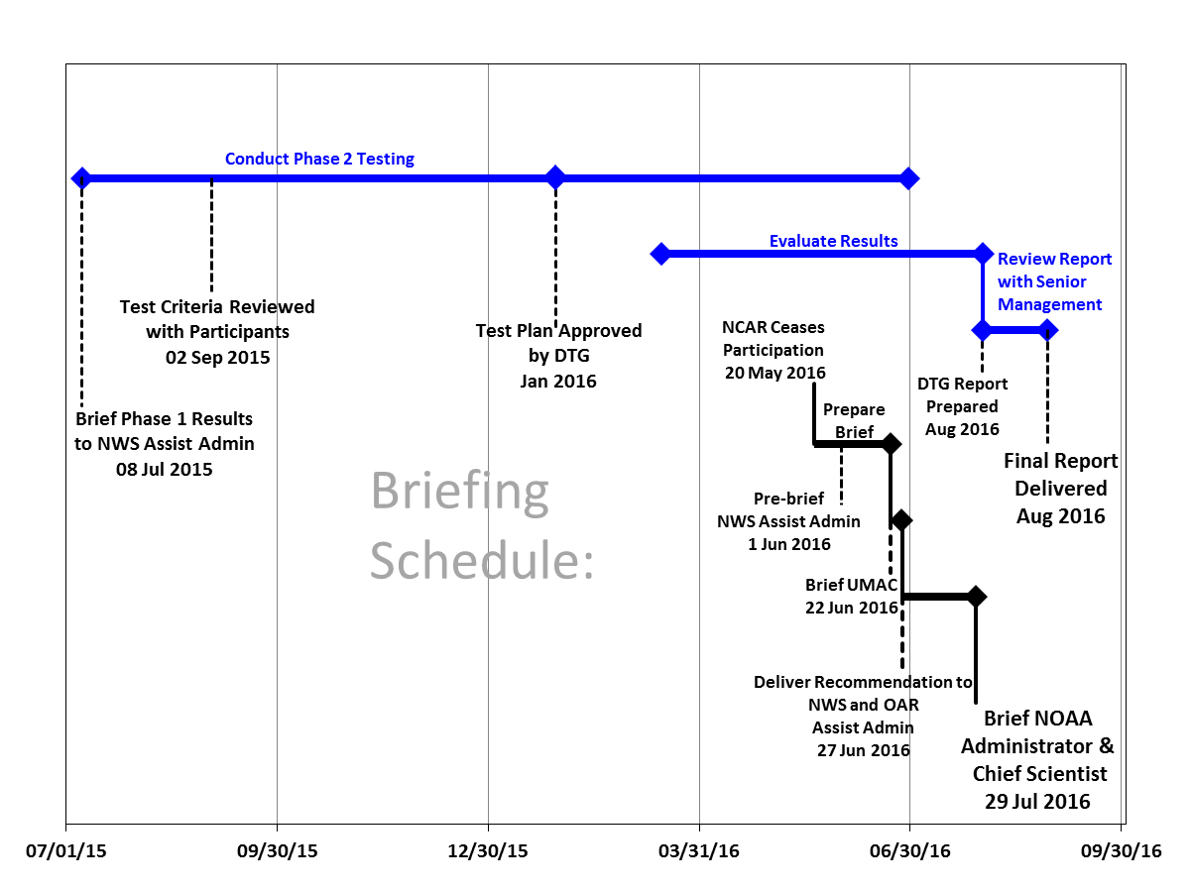
Phase 2 Testing, Evaluation and Reporting Schedule
26 July 2016
19 Jul 2016

Slide 39
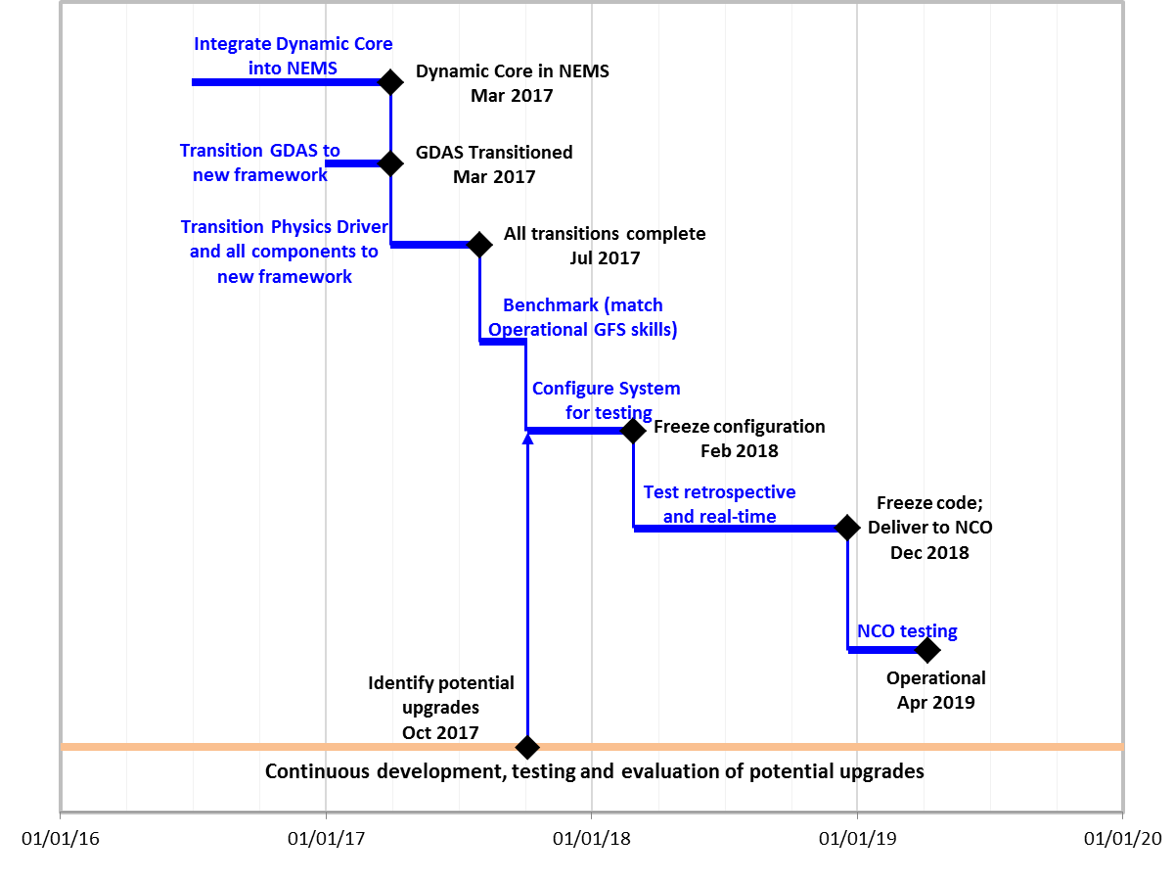
Phase 3 Implementation Detail
19 Jul 2016

Slide 40
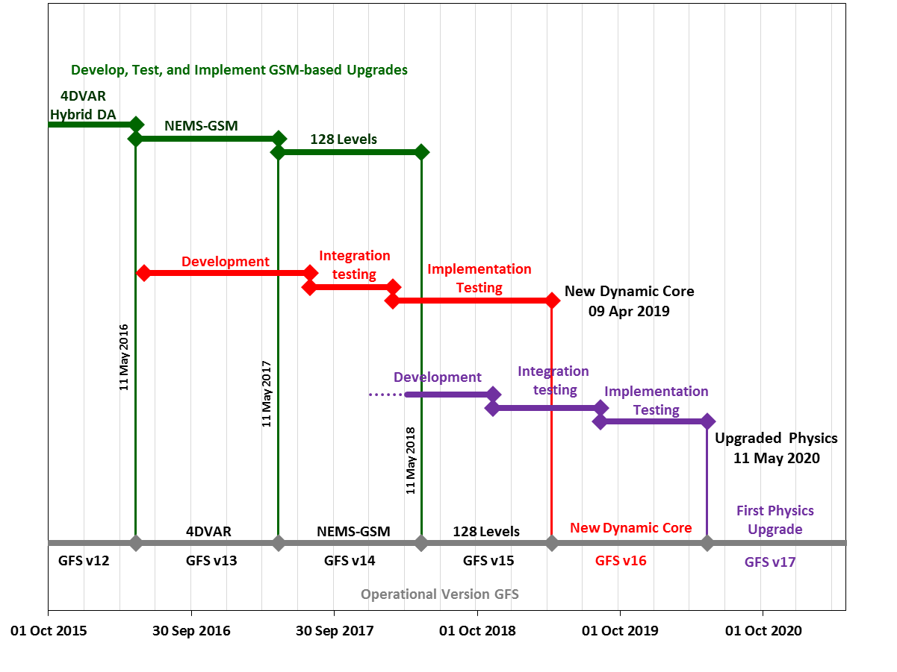
GFS Development and Operational Upgrade Plan
Now

Slide 41
DTG Assessment
The overarching goal of NGGPS is to develop the World’s best global numerical weather prediction guidance. FV3's heritage in global applications is a strength, and the test results suggest that FV3 can have cost effective, positive impacts on global products in a relatively short amount of time. The test results have not revealed any deficiencies with FV3 to preclude the representation of convective storms. For MPAS, the test results suggest that the extension to NCEP's global application suite will require more time to provide comparable product quality and the computational costs will be higher.
– Statement of DTG
Notes:
FV3 Dynamic Core will satisfy development of NGGPS and serving NWS needs for global weather and climate applications.
Out of the box, FV3 produced skillful forecasts comparable to GFS.

Slide 42
Summary and Conclusions
The FV3 Core represents the lowest risk, lowest cost alternative for the new NGGPS atmospheric model
Adopting FV3 core brings with it a dynamic, vibrant community
  GFDL is a world-class organization in Global Modeling Applications for Weather and Climate
  GFDL is a willing partner to the NWS in advancing operational Global weather modeling applications
  Other Agencies/Entities using Finite Volume Core include NCAR (CESM), NASA (GEOS/GISS), Harvard (GEOS-Chem), Columbia Univ. (pollution studies), U. of Washington (Dale Durran), Chinese Academy of Sciences (IAP), Germany (ECHAM5), Japan (MIROC)
Integration of FV3 with Common Community Physics Package and GMTB can support interaction with convective weather modeling community
From the beginning, the NGGPS strategy has been to find and implement the best global model (unification at regional scales/picking the best convective model, while desirable, has not been an objective of NGGPS)
  Nothing in results precludes eventual global-regional unification based on FV3
Notes:
Institutions using FV3 cores:
1. GFDL: All atmosphere models developed since 2004 (including for NMME)
2. Users of FLOR and HiFLOR
3. NCAR (CESM)
4. NASA GSFC: GEOS-4 and GEOS-5
5. NASA GISS: model E (cubed-sphere version)
6. Harvard University (GEOS-Chem)
7. Columbia University
8. University of Washington (Dale Durran)
9. Institute of Atmospheric Physics (IAP), Chinese Academy of Sciences (IPCC)
10. ECHAM5, Germany (IPCC)
11. MIROC, Japan (IPCC)

Slide 43
Detailed Phase 2 Test Results

Slide 44
#1: Whole Atmosphere Model (WAM) Suitability
SWPC WAM development team considered approaches by MPAS and FV3 to SWx requirements:
  Both dycore teams have adequate plans in place for addressing SWx requirements for the next generation WAM and no preference was given to either dycore
  Some requirements are not fully addressed by either dycore such as the approach to thermodynamics in a whole atmosphere
  Significant effort still remains to adapt both dycores to the full atmosphere altitude/pressure domain currently covered by WAM
Notes:
- Source: 26 May 2016 SWPC (Rodney Viereck) email. For criteria #1, each group submitted plans for implementing features in their dycores that will be needed to support whole atmosphere applications. These plans were evaluated by SWPC and their feedback is summarized here.

Slide 45
#2: Conservation Test: RMS Difference Between Advected Tracer and Dynamical Field (Day 15)
FV3 RMS=0.232
MPAS RMS=0.126
GFS RMS=0.202
Proxy Θe
Proxy Θe
Proxy Θe
Θe
Θe
Θe
Scatterplots of Θe and proxy Θe (tracer) at day 15 for the moist baroclinic wave (DCMIP test 4.2). Compare with Figure 1 of Johnson et al. 2000.
FV3, GFS and MPAS are similar, much better than CCM3 result from Johnson et al.
UW RMS=0.69
CCM3 RMS=10.6
Day-10 scatter plots from Johnson et al. 2000

Slide 46
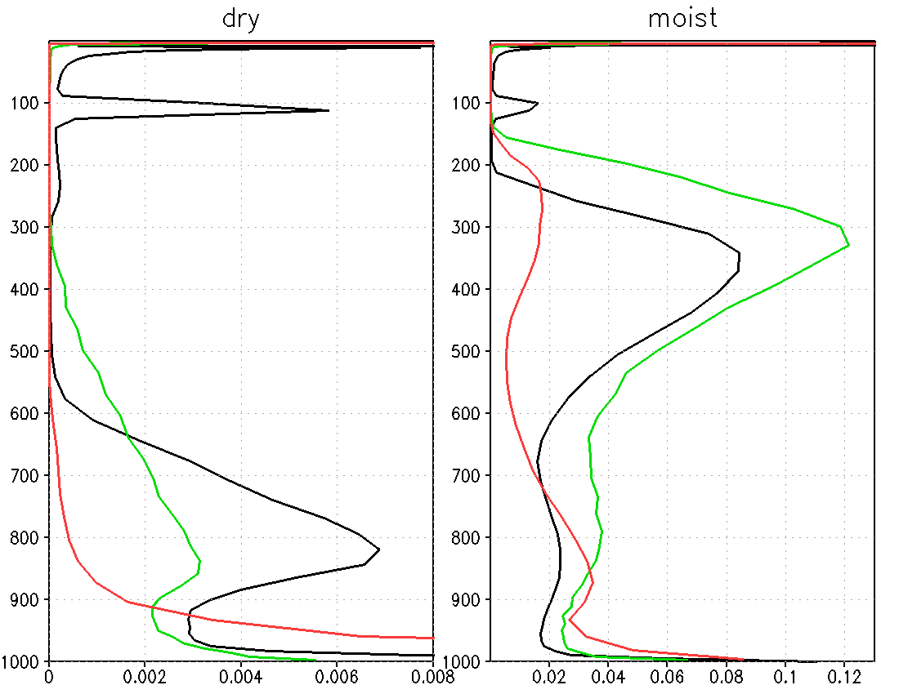
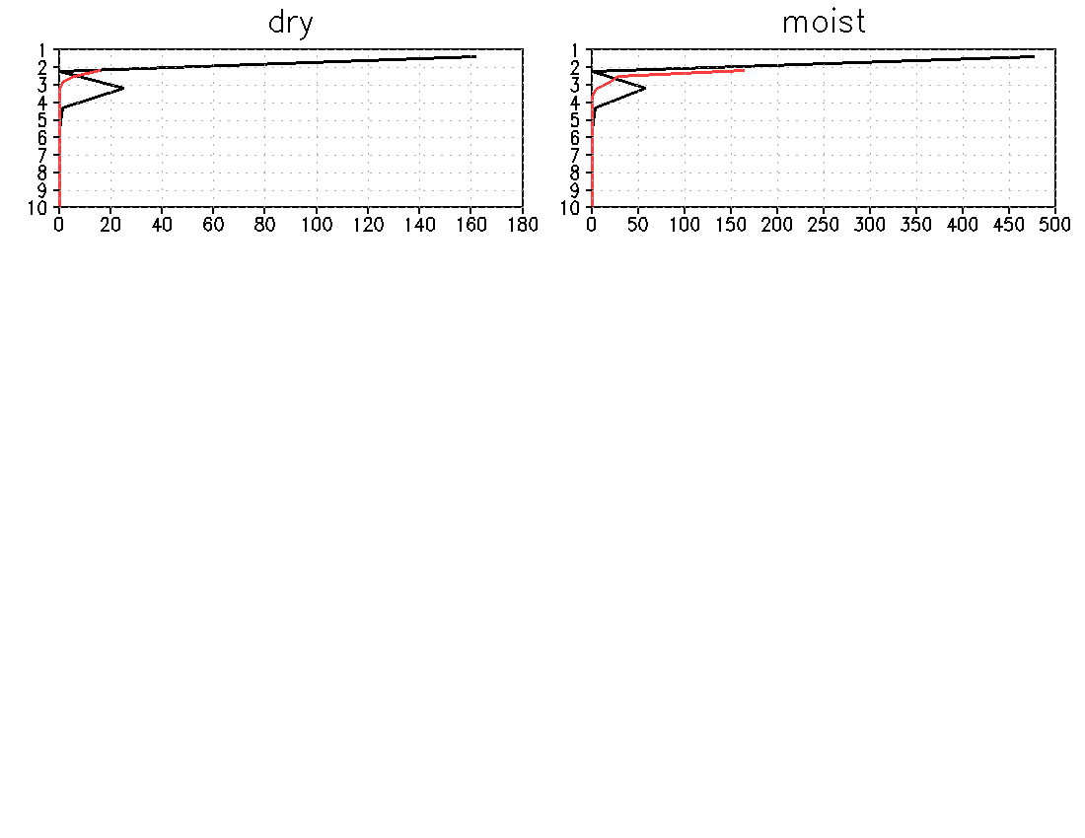
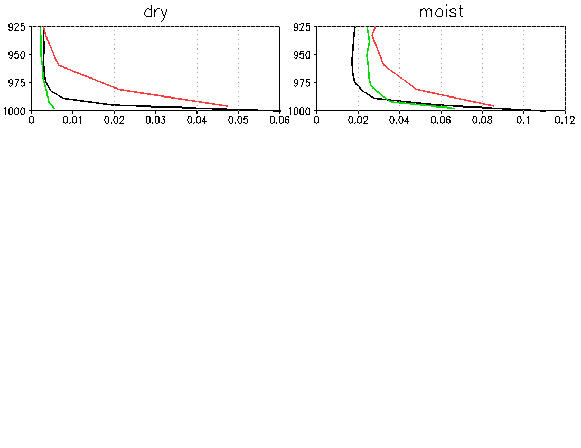
#2: Conservation Test: RMS Difference Between Advected Tracer and Dynamical Field (Day 15)
GFS
FV3
MPAS
Pressure
Global average RMS difference between prognostic equivalent potential
temperature and tracer equivalent potential temperature calculated for each model level. Insets on right show detail at lower and upper levels of model, note that x-axes scales are much larger in insets.

Slide 47
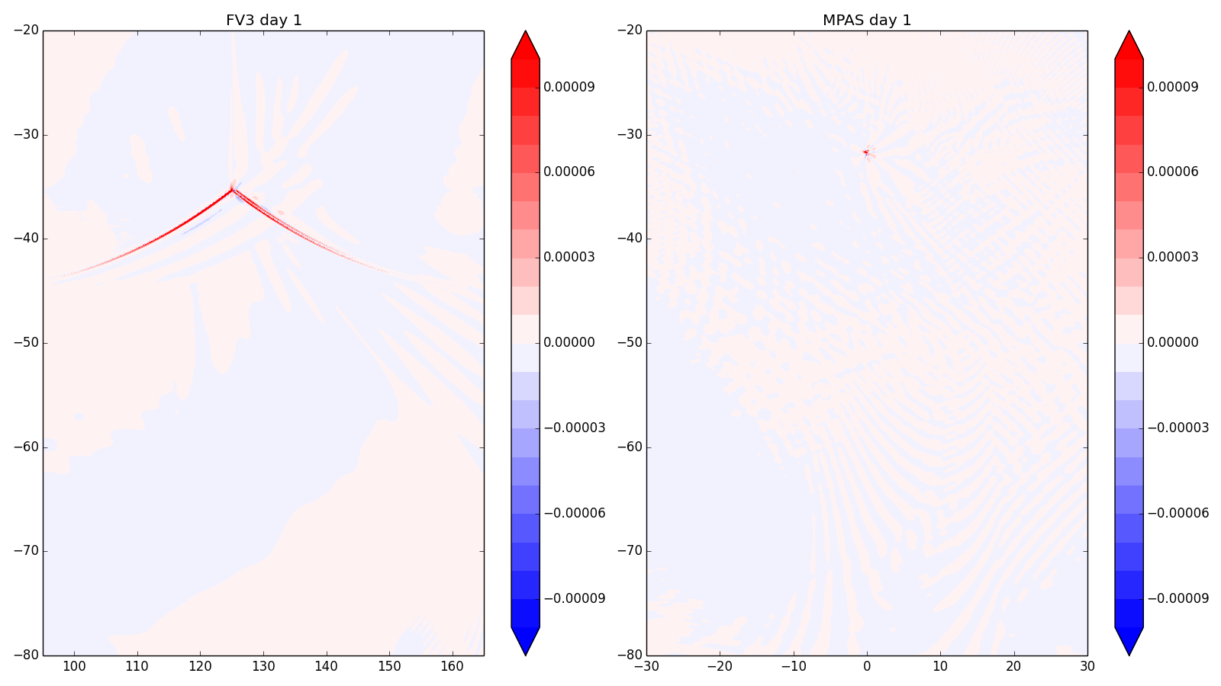
#2: Conservation Test Case (Grid Imprint Assessment): Dry Case (Southern Hem) Vertical Velocity at Lowest Level, Day 1 (Zonal Mean Removed)
cube corner
pentagon
Notes:
In southern hemisphere, there should be no activity – so spurious motions associated with grid imprinting are easier to see. The two ‘special’ points on the grid are highlighted. Amplitudes are very small. FV3 signal extends along cube edges away from corner.

Slide 48
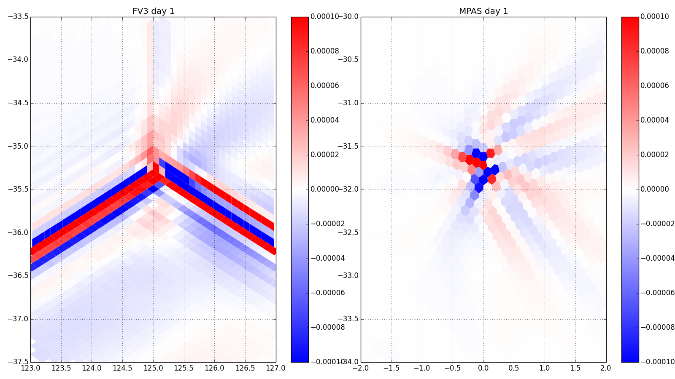
#2: Conservation Test (Grid Imprinting Assessment): Zoom-in on Cube Corner, Pentagon (Level 1 w)
Notes:
Signal is stationary and does not grow.

Slide 49
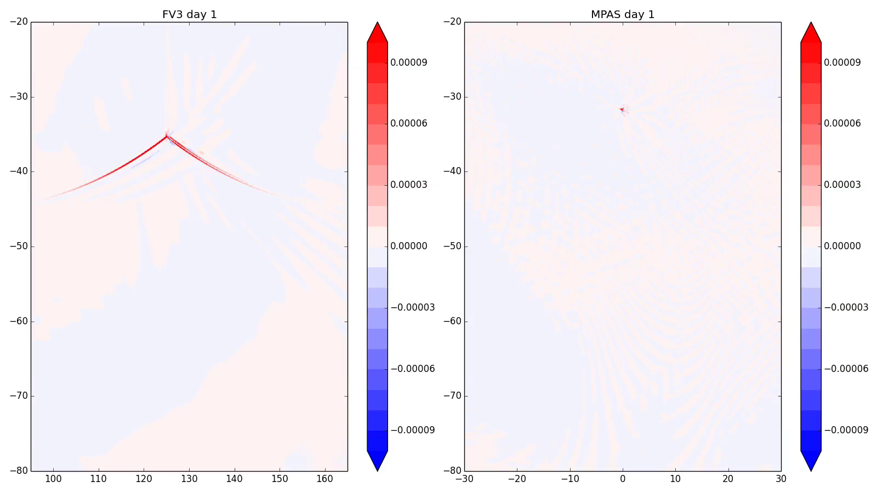
#2: Conservation Test (Grid Imprinting Assessment): Animation of Level 1 w
Notes:
Note growth of spurious small scale instability in MPAS solution. Very shallow, not related to grid imprinting. Larger scale expected baroclinic wave signal emerges in FV3 solution, also seen in MPAS solution.

Slide 50
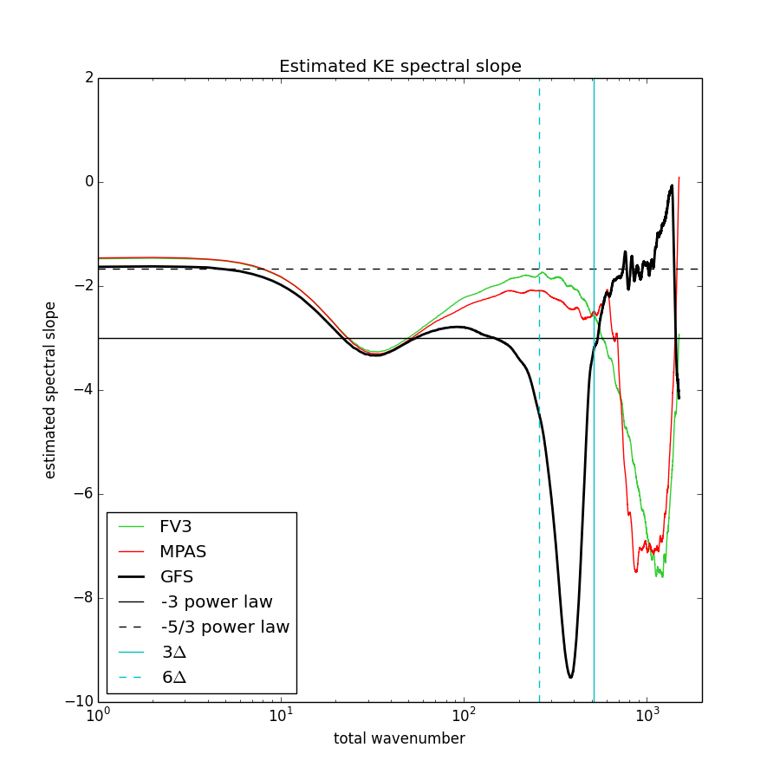
#4: Performance Benchmark Results: Estimated Spectral Slope
Notes:
Vertical lines are 4dx and 8dx. Horizontal lines are -3 and -5/3.

Slide 51
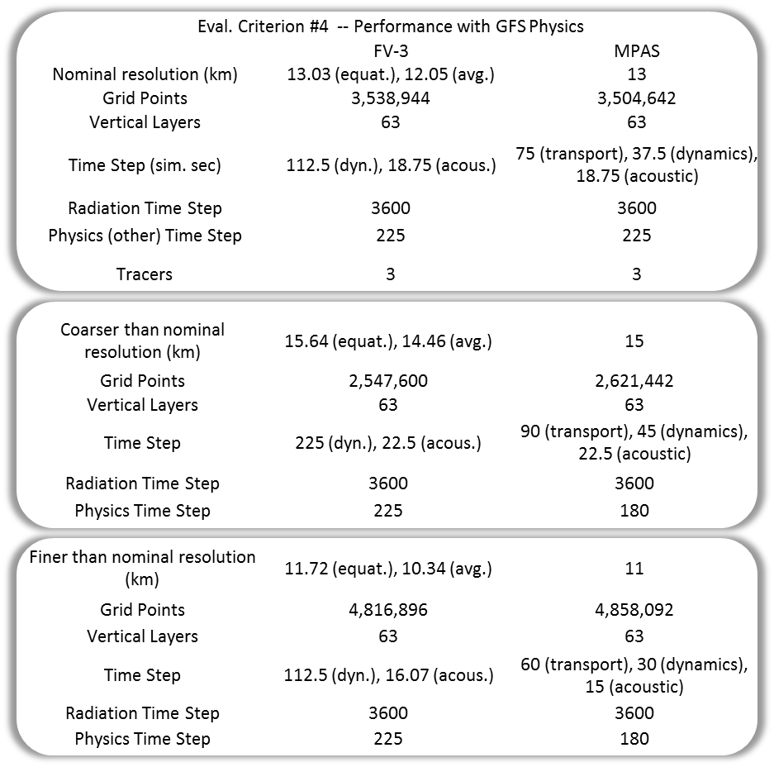
#4: Performance Benchmark Results: Configurations

Slide 52
#4: Performance Benchmark Results: Tracer advection performance
Tracer advection benchmarks on Cori
  Measure cost as a function of number of 3D tracer fields
    Workloads and configuration:
      13 km case on number of cores needed for 8-8.5 min/day
    Baseline: 3 tracer fields
    Add 15 and 30 artificial tracers
  Result: cost for full tracer load increased by factor of 2.5 for MPAS versus 1.53 for FV3 compared to baseline.
Adjustment for FV3 workloads using 15 and 30 tracers total instead of 15 and 30 additional tracers per Test Plan.

Slide 53
#4: Performance Benchmark Results: Refinement Configuration
FV3
Histograms of grid cell size
MPAS

Slide 54
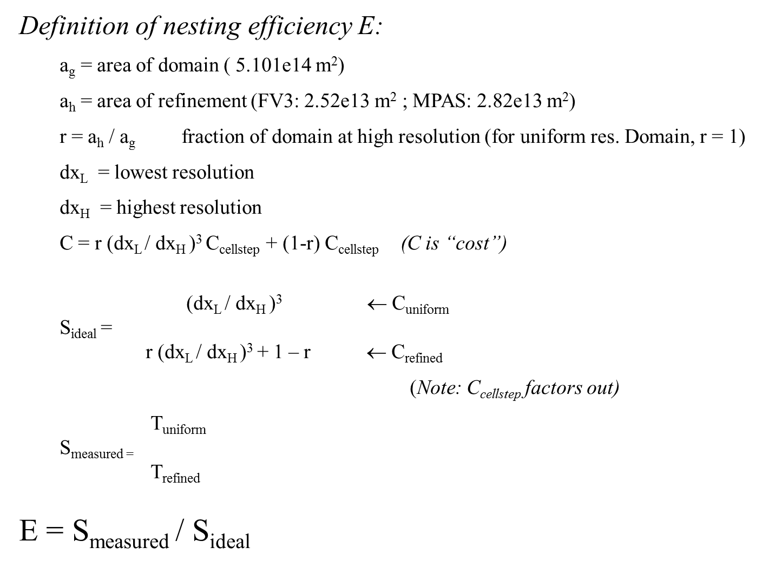
#4: Performance Benchmark Results: Refinement Efficiency
Part of Criterion #5 evaluation
How efficient is non-uniform at saving cost compared with uniform 3 km resolution on same number of processors?
Benchmark and adjust for differences in resolution and area of refinement
FV3’s nesting scheme was more efficient than MPAS’s in-place mesh refinement

Slide 55
#4: Performance Benchmark Results: Refinement Efficiency (continued)
Part of Criterion #5 evaluation
How efficient is non-uniform at saving cost compared with uniform 3 km resolution on same number of processors?
Benchmark and adjust for differences in resolution and area of refinement
FV3’s nesting scheme was more efficient than MPAS’s in-place mesh refinement

Slide 56
#5: Modifications to Phase 1 Supercell Test Case Configuration
MPAS
  Disable vertical diffusion
  Set Prandtl number to 1 (so that horizontal diffusion coefficient is same for all variables)
  Physics timestep same as large RK step
  Large RK step set to 3,6,12,24 seconds for 500m,1km,2km,4km resolutions
  Number of acoustic timesteps per large RK step set to 6 in all cases
FV3
  Disable Smagorinsky diffusion by setting dddmp=0
  Disable monotonic horizontal transport
  Turn on 2nd order horizontal diffusion of tracers (using inline_q=.T. to ensure that tracers are integrated on the same time step as other prognostic variables)
  Physics timestep set to 20,20,20,25 secs for 500m,1km,2km,4km resolutions
  Number of vertical remaps per physics timestep (k_split) set to 8,5,2,1 for 500m,1km,2km,4km resolutions
  Number of acoustic time steps per vertical remap (n_split) set to 5 in all cases
With these mods, both models use constant 2nd order horizontal diffusion for all variables, no vertical diffusion. A horizontal diffusion coefficient of 2000 m²/s is used, since it appears to produce a converged solution at 500 m for both models.

Slide 57
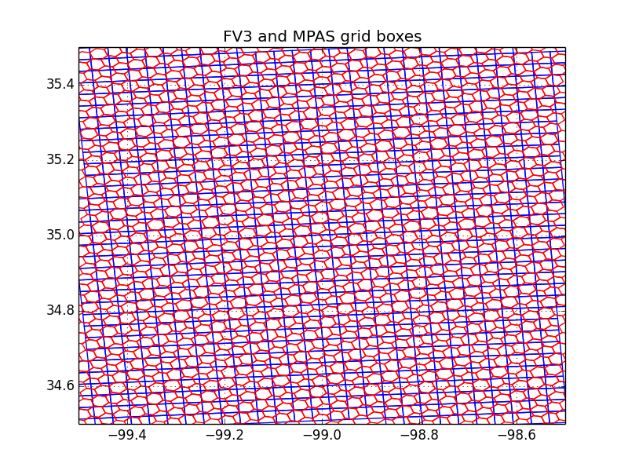
#5: Variable Resolution Tests:
Grid Structure in Region of Interest
MPAS grid cells (red) are smaller in the region of interest
Notes:
FV3 is a nest, MPAS is a telescoping mesh with highest resolution in center. FV3 nest resolution is quasi-uniform (with slightly higher resolution near nest corners, lower resolution in center of nest).

Slide 58
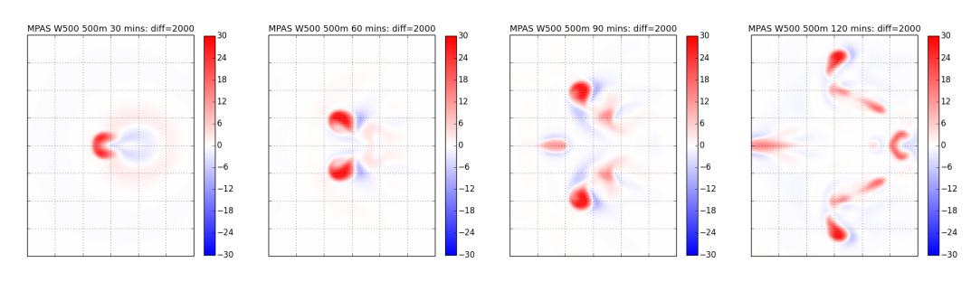
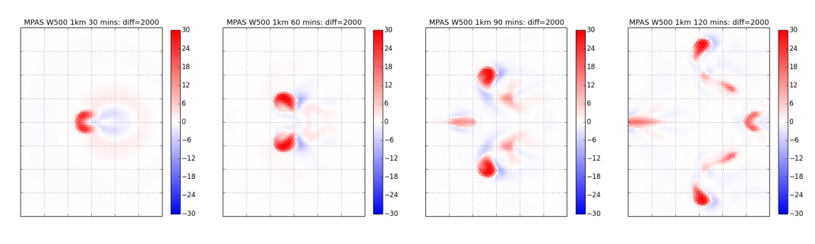
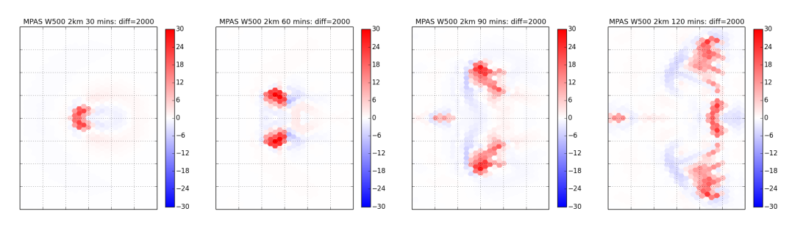
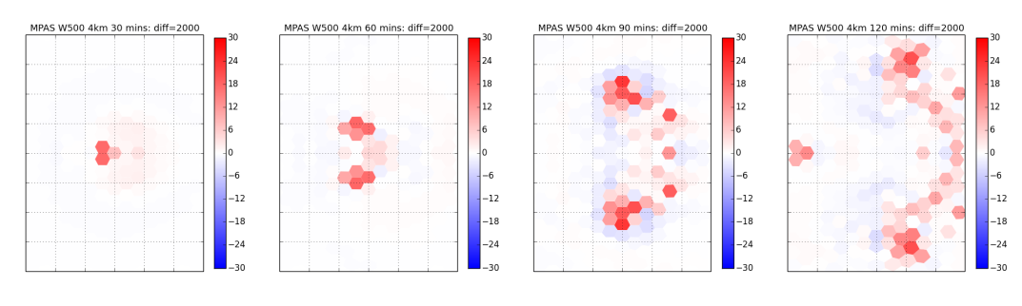
#5 Supercell Test: MPAS 500 hPa w
0.5km
1 km
2 km
4 km

Slide 59
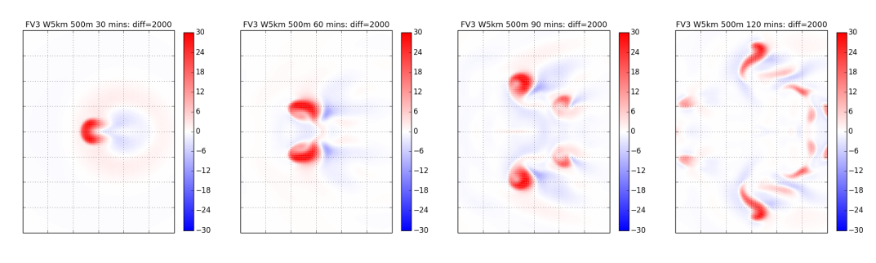
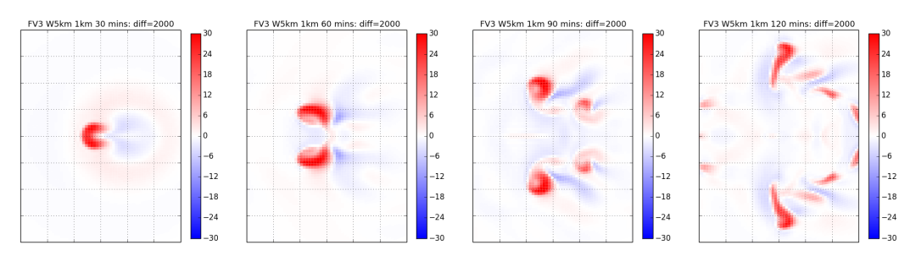
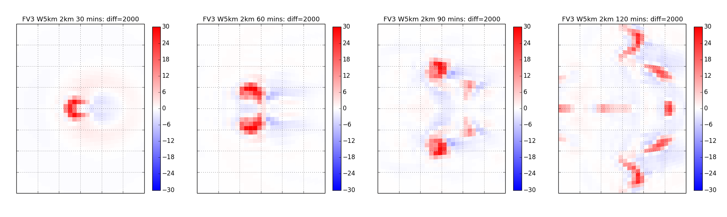
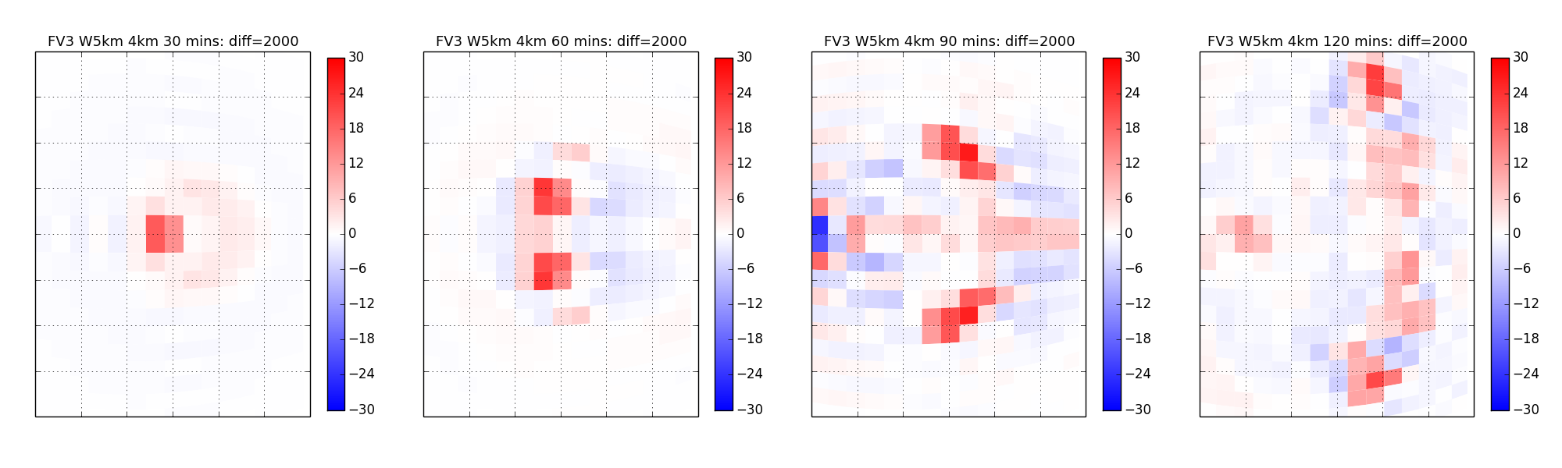
#5: Supercell Test: FV3 500 hPa w
0.5km
1 km
2 km
4 km

Slide 60
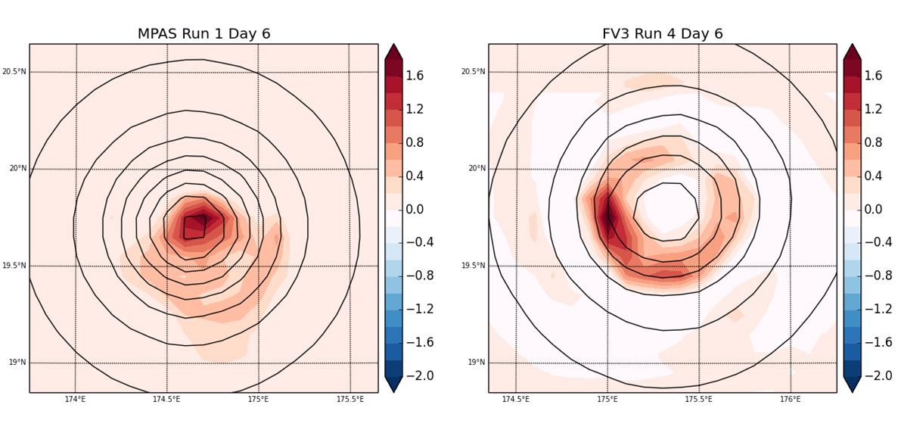
#5: Idealized TC Test
MSLP (black lines), 500hPa Vertical Velocity (color, m/s)
MPAS updraft is maximum in center of storm – no local minimum in eye.
FV3 updraft is still concentric, with subsidence in eye.
*MPAS real-data TC simulations did not have this structure.
Notes:
The idealized TC test, based on the DCMIP 2012 specification, could not be run on the reduced radius sphere, so the horizontal resolution is coarser (13km). Here is the solution at day 6 for MPAS and FV3, showing the MSLP and vertical velocity.
Since MPAS TC structures did not have this issue in real data forecasts, it is likely that this is an artifact of the simple physics configuration and not a fundamentally related to dycore numerics. Simple physics PBL may be quite sensitive to placement of 1st vertical level.

Slide 61
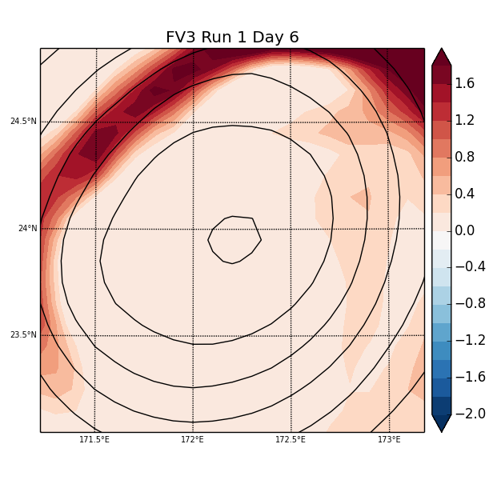
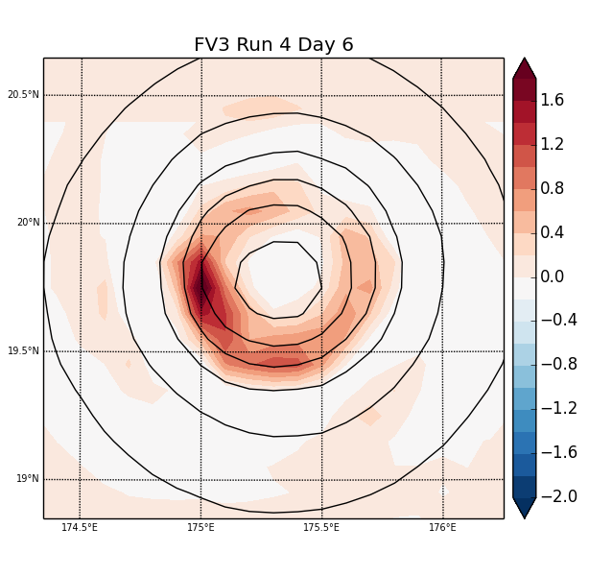
#5: Idealized TC Test
MSLP (Black Lines), 500hPa Vertical Velocity (color, m/s)
FV3 as originally configured has a huge eye (left); removing the vertical 2dz filter produced a much smaller, more realistic storm structure (right).
Notes:
DCMIP idealized TC test. Color-filled field is vertical velocity, solid contours are MSLP.

Slide 62
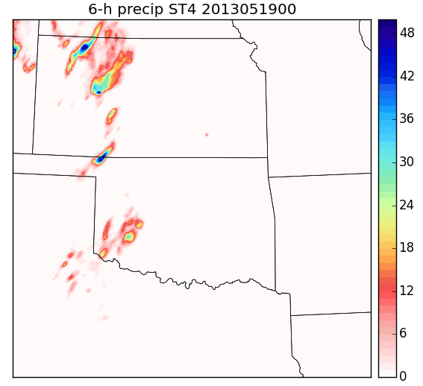
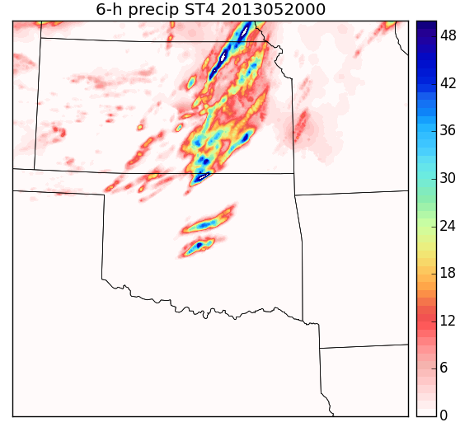
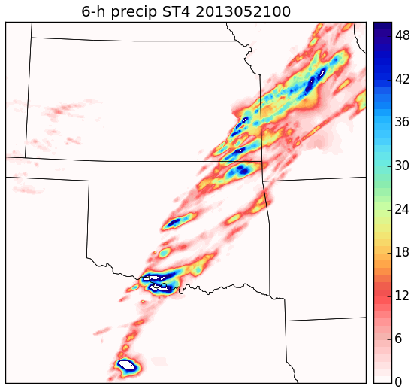
#5: Moore Tornado Case: Stage IV Precipitation Analyses

Slide 63
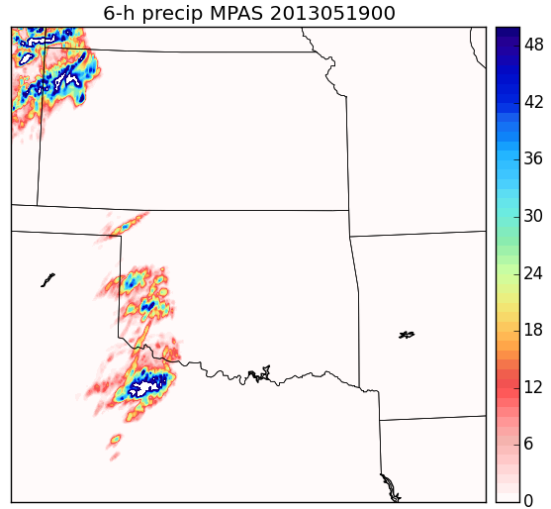





6-h acc precip (mm) for 00UTC May 19,20,21 (days 1-3)
#5: Moore Tornado Case: Simulated Precipitation
Notes:
Contours saturate at 50mm (higher values show up as white). More precip in MPAS.

Slide 64






Total Condensate (mm) for 00UTC May 19,20,21 (days 1-3)
#5: Moore Tornado Case: Simulated Total Cloud Condensate

Slide 65

#6: Long Integrations: Grid Imprinting
90 Day Mean W at Level 30
Pentagon
Cube corner

Slide 66

#6: Long integrations: Grid Imprinting
90 Day Mean W at Level 30 (zoom in)
Notes:
Grid imprinting signal at 50 km resolution larger in FV3

Slide 67

Blizzard of January 26-27, 2015
Forecasts initialized 00UTC Jan 21
All 3 models predicted a coastal storm beyond day-5, with the largest accumulations in eastern New England.

Slide 68

Blizzard of January 26-27, 2015
Forecasts initialized 00UTC Jan 26
All 3 models produced more precipitation than Stage IV QPE, but were able to predict that the largest accumulations would be east of New York city.

Slide 69
Criteria #7 and #8
#7: Code adaptable to NEMS/ESMF
  Self-reporting on questionnaire from EMC. GFDL completed (no issues) / NCAR incomplete
#8: Detailed dycore documentation
  Complete – Both dycores sufficiently documented for Phase 2 evaluation (but more will be needed for community model environment)

Slide 70
#10: Implementation Plan - Costs
Initial Implementation (transition to operations) Cost in FTEs (in addition to existing personnel managing O&M for operational GFS)
Activity | FY17 |  | FY18 |  | FY19 |  | FY20 |  | Total
 | MPAS | FV3 | MPAS | FV3 | MPAS | FV3 | MPAS | FV3 | MPAS | FV3
Dycore integration into NEMS | 3 | 3 | 2 | 2 | 2 | 2 | 2 | 0 | 9 | 7
Physics implementation | 2 | 1 | 2 | 1 | 1 | 1 | 1 | 0 | 6 | 3
Physics Driver implementation | 1 | 1 | 2 | 1 | 1 | 1 | 1 | 0 | 5 | 3
DA integration | 4 | 2 | 3 | 2 | 3 | 2 | 2 | 0 | 12 | 6
Pre/Post | 2 | 2 | 2 | 2 | 1 | 1 | 1 | 0 | 6 | 5
Benchmarking | 0 | 0 | 4 | 3 | 4 | 4 | 5 | 0 | 13 | 7
Code Management | 2 | 2 | 2 | 2 | 2 | 2 | 2 | 2 | 8 | 8
Computational efficiency | 2 | 1 | 2 | 1 | 2 | 1 | 2 | 0 | 8 | 3
Transition to operations | 0 | 0 | 0 | 0 | 0 | 3 | 3 | 0 | 3 | 3
Total | 16 | 12 | 19 | 14 | 16 | 17 | 19 | 2 | 70 | 45
Computer Resource Requirements for Initial Implementation (FY17-FY19 for FV3 and FY17-FY20 for MPAS)
 | CPU* |  | CPU Hours** |  | Disk |  | Period |  | % change w.r.t. GFS
GFS | 5,150,880 |  | 399,840 |  | 10 PB |  | FY17-FY18 |  | 0
FV3 | 6,565,620 |  | 509,660 |  | 30 PB (2 streams) |  | FY17-FY19 |  | 28%
MPAS | 19,959,660 |  | 1,549,380 |  | 45 PB (3 streams) |  | FY17-FY20 |  | 288%
*CPU* = Y x 4 cycles x 365 days x 3 years, Y is number of cores required for 8.5 min/day
Y = 1176 (GFS), 1499 (FV3), 4557 (MPAS) based on current operational resolution (~13 km). |  |  |  |  |  |  | 1176 | 1499 | 4557
Computational requirements for intended implementation configuration TBD
**CPU hours = Y x 8.5 min/day x 10 days x 4 cycles
HPC resources for Data Assimilation is not included
Availability of computational resources will require development/testing of FV3 in two parallel streams while MPAS would require three parallel streams
Summary | Implementation Costs (Human Resources) for MPAS are 55% more compared to FV3
 | Implementation Costs (computational resources) for MPAS are 204% more compared to FV3
Notes:
Criteria #10 involves an assessment of the resources required to implement either dycore as a replacement for the spectral dycore in the GFS. Here is EMC’s estimate of the manpower and computational resources needed over the next 3-4 years. The computational resource numbers are based directly on the benchmark performance tests (criteria #4), and show that FV3 would require a 28% increase in HPC to replace the GFS at the same nominal resolution, but MPAS would require almost a factor of 3 increase in operational computing (unless further efficiency improvements are made).. EMC estimates that MPAS will require about 50% more manpower – this mainly reflects the added work needed to improve the forecast skill and DA performance, and to improve the computational efficiency.
- Availability of computational resources will require development/testing of FV3 in two parallel streams while MPAS would require three parallel streams

Slide 71
Phase 1 Test and Evaluation

Slide 72
Selecting a New Operational
Atmospheric Dynamic Core
Evaluate, select and implement a replacement to current Global Spectral Model
Parallel efforts initiated at UKMO and ECMWF
Next-Generation computing paradigm will require scaling across potentially 100,000’s processors or more
Candidate dynamic core testing is being conducted in two phases

Slide 73
Atmospheric Model Dynamic Core
Testing Overview
Phase 1 Testing
Status | Activities
Complete | HIWPP Idealized Tests
Complete | Computational performance and scalability testing and software evaluation by Advanced Computing Evaluation Committee (AVEC)
Complete | HIWPP 3-km, 3-Day Simulations
Complete | Phase 1 Testing Report
Complete | Dycore Test Group (DTG) assessment of Phase 1 testing results
Complete | Phase 1 testing results briefing to NCEP (Dr. Bill Lapenta)
Note: Specific details on Phase 1 testing and associated criteria provided later in brief

Slide 74
NGGPS Phase 1 Testing
AVEC
  Benchmarks Testing
  Software Evaluation
HIWPP
  Idealized Tests
  3-km, 3-Day Simulations
Incorporated Non-hydrostatic Dynamic Core Testing from HIWPP

Slide 75
NGGPS Phase 1 Dycore Test
Candidate Model Dynamic Cores
FV3 (GFDL): Cubed-sphere finite-volume with flexible Lagrangian vertical coordinate (z or p base) with nesting or stretched grid capability
MPAS (NCAR): Finite-volume C-grid staggering, icosahedral (z coordinate) with unstructured mesh refinement capability.
NIM (ESRL): Icosahedral unstaggered A-grid mesh, finite-volume (z coordinate)
NMM-UJ (EMC): Finite-difference, cubed-sphere version of Non-hydrostatic Mesoscale Model (p coordinate); Uniform Jacobian cubed sphere grid replaced lat/lon grid version with staggered B-grid (NMMB)
NEPTUNE (Navy): Spectral-element (horizontal and vertical) cubed-sphere grid (z coordinate) with adaptive mesh refinement
Global Spectral Model not included – Non-hydrostatic version not available

Slide 76
Phase 1 Dycore Testing Overview

Slide 77
NGGPS Phase 1 Dycore Testing
Test Personnel
NGGPS Test Manager – Jeff Whitaker (OAR)
AVEC Test Manager – John Michalakes (NWS Contractor)
FV3 Test Manager – Shian-Jiann Lin (GFDL)
MPAS Test Manager – Bill Skamarock (NCAR)
NMM-UJ Test Manager - Geoff DiMego (EMC)
NEPTUNE Test Manager – Jim Doyle (Navy)
NIM Test Manager – Jin Lee (ESRL)

Slide 78
NGGPS Phase 1 Testing
Ground Rules
Each candidate model’s configurations – resolution, number of points, number of levels, and time step were reviewed and agreed upon by other modeling groups
Strict schedules with deadlines were followed
  Candidate dycore development paths not in sync with NGGPS timeline in all cases
Any dycore testing modifications during test were approved by the NGGPS Manager, Test Manager and other dycore leads
  Included substitution of NMM-UJ for NMMB and additional runs of dycores at single vs double precision
  Both AVEC testing and idealized testing used same versions of code – modifications required re-running some tests for standardization

Slide 79
AVEC Phase 1 Evaluations

Slide 80
AVEC Phase 1 Evaluations
Advanced Computing Evaluation Committee formed August 2014 to evaluate and report on performance, scalability and software readiness of five NGGPS candidate dycores
Reports
  NGGPS Phase 1 Benchmarks – April 30, 2015
  NGGPS Phase 1 Software Evaluation (addendum to above) – May 28, 2015
Benchmarks on 130-thousand core HPC system at DOE: “Edison”
  13-km and 3-km workloads based on HIWPP non-hydrostatic test case
  Model groups agreed on each others’ configurations
  Time step and other configuration options were “best guesses”
  Groups that changed codes or configurations to improve benchmark performance were required to resubmit results for HIWPP test case
Round 2 benchmarks in Phase 1 afforded groups the opportunity to make adjustments (single vs double precision, run with additional higher processor counts, 3rd vs 4th order, and improvements in MPI communications)

Slide 81

AVEC Phase 1 Evaluations:
Performance
Performance:
  Number of processor cores needed to meet operational speed requirement with 13-km workload
  Rankings (fastest to slowest): NMM-UJ, FV3, NIM, MPAS, NEPTUNE
(Lower is better)
ECMWF
Guest Dycore

Slide 82

AVEC Phase 1 Evaluations:
Scalability
Scalability: ability to efficiently use large numbers of processor cores
  All codes showed good scaling
  Rankings (most to least scalable): NEPTUNE, MPAS, NIM, FV3, NMM-UJ
(Higher is better)
ECMWF
Guest Dycore

Slide 83
AVEC Phase 1 Evaluations:
Software
Software evaluations intended to highlight strengths and weaknesses of codes to be ready for NGGPS
  Note: snapshot in time, all codes under active development
Phase 1 results based on self-reports from AVEC questionnaire*:
  Software maturity: FV3, NIM, MPAS, NEPTUNE, NMM-UJ
  Nesting or mesh refinement: FV3, MPAS, NEPTUNE, NMM-UJ, NIM
  Support for thread parallelism: FV3, NIM, NMM-UJ, MPAS, NEPTUNE
  Reproducibility: FV3, NIM, NMM-UJ, MPAS, NEPTUNE
  Advanced architectures: NIM, FV3; NMM-UJ, NEPTUNE, MPAS
Additional evaluation including detailed code inspection and review of documentation will continue into Phase 2 testing
*Stoplight color coding by AVEC Chair, John Michalakes (not full AVEC)

Slide 84
  HIWPP Tests
  Supporting
  NGGPS Phase 1 Testing

Slide 85
Idealized Tests
Baroclinic wave test with embedded fronts (DCMIP 4.1)
  Dynamics strongly forces solution to shortest resolvable scales
  Shows impact of truncation error near quasi-singular points on computational grid (“grid imprinting”)
  15/30/60/120 km horizontal resolutions with 30 and 60 vertical levels
Non-hydrostatic mountain waves on a reduced-radius sphere (like DCMIP 2.1/2.2)
  Shows ability to simulate non-hydrostatic gravity waves excited by flow over orography
  3 tests: M1 (uniform flow over a ridge-like mountain), M2 (uniform flow over circular mountain), M3 (vertically sheared flow over a circular mountain). Solutions are all quasi-linear
Idealized supercell thunderstorm on a reduced-radius sphere
  Convection is initiated with a warm bubble in a convectively unstable sounding in vertical shear
  Simple Kessler warm-rain microphysics, free-slip lower boundary (no boundary layer)
  Splitting supercell storms result after 1-2 hours of integration
  0.5/1/2/4 km horizontal resolutions

Slide 86

Baroclinic Wave (Sfc Wind Speed at
Day 9, 15-km resolution)

Slide 87

Supercell (2500-m w at 90 mins,
4-km resolution)
dt=24 secs
dt=20 secs
dt=2 secs
dt=8 secs
dt=2 secs
Notes:
- NEPTUNE is the only model using the deep atmosphere equations.

Slide 88
72-h 3-km Forecast Test
‘Stress-test’ dycores by running with full-physics, high-resolution orography, initial conditions from operational NWP system
  Different physics suites used in each model
Two cases chosen:
  Hurricane Sandy 2012102418 (also includes WPAC typhoon)
  Great Plains tornado outbreak (3-day period beginning 2013051800). Includes Moore OK EF5 tornado around 00UTC May 19
Focus not on forecast skill, but on ability of dycores to run stably and produce reasonable detail in tropical cyclones and severe convection
  Also look at global quantities like KE spectra, total integrated precipitation/water vapor/dry mass

Slide 89

Hurricane Sandy (w at 850 hPa)

Slide 90

Moore Tornado (w at 500 hPa)

Slide 91
Idealized Testing
Summary
FV3, MPAS produced highest quality solutions overall
  More similar to each other than other models for all tests
NIM produced reasonable mountain wave and supercell solutions
  Excessive noise near grid scale in baroclinic wave solution
  Full physics forecasts excessively damped
NEPTUNE was not able to produce full physics 3-km forecasts
  Baroclinic wave too smooth, 4-km supercell not split by 90 mins
NMM-UJ did not produce realistic solutions for the mountain wave and supercell tests
  Vertical velocity fields from full physics forecasts did not show signatures expected from resolved convection

Slide 92
Dycore Test Group (DTG)
Membership
Chair: Ming Ji (Director, Office of Science and Technology Integration)
Fred Toepfer (NGGPS Program Manager)
Bob Gall, Ricky Rood, John Thuburn (Independent Consultants)
Melinda Peng (Navy – NEPTUNE)
Venkatachala Ramaswamy (GFDL - FV3)
Hendrik Tolman (EMC – NMM-UJ)
Chris Davis (NCAR – MPAS)
Kevin Kelleher (ESRL – NIM)

Slide 93
NGGPS Phase 1 Testing
DTG Assessment
Several dycores identified that consistently produced solutions of higher quality and/or were more mature than other dycores - low technical risk
Low Risk Decision - Sufficient information is available to proceed with fewer dycores to Phase 2 testing
  No additional testing required to remove programmatic risk
  No unique quality lost in any models not moving forward
Majority agreed
  FV3 and MPAS were ready to move Phase 2 testing
  Additional development needed for other NMM-UJ, NIM, and NEPTUNE
Notes:
-

Slide 94
NGGPS Phase 1 Testing
Project Summary Assessment
 | Idealized Tests | 3-km, 3-day forecasts | Performance | Scalability | Nesting or Mesh Refinement | Software Maturity
FV3
MPAS
NIM
NMM-UJ
NEPTUNE
Meets or exceeds readiness for needed capability
Some capability but effort required for readiness
Capability in planning only or otherwise insufficiently ready

Slide 95
Dycore Readiness
Project Risk Assessment
 | Overall Risk | Comment
FV3 | Low | None
MPAS | Mostly Low | Computational Performance
NIM | Moderate | Maturity – Nesting, high resolution
NMM-UJ | Moderate | Maturity – Idealized Testing
NEPTUNE | High | Maturity
Neither readiness for potential future computing architectures (fine-grain computing) nor future computing relative scarcity/abundance judged to be overarching requirements at this time

Slide 96
Project Manager Assessment
Relative dycore performance in testing results
  FV3 and MPAS achieved both acceptable and highest quality testing results
  MPAS markedly slower than FV3 but MPAS team anticipates significant improvement available and achievable
  Significant additional development (months to years) potentially needed for other cores to achieve comparable (not better) performance
Significant long-term schedule risk added if we delay for additional dycore development and/or Phase 1 testing
  No guarantee of relative improvement between dycores
  Potential for open-ended development across multiple models
Cost - Limited resources, both in personnel and funding, and should be focused on development or readiness of top dycore candidates for operations
Must consider planned model develop
Notes:
-

Slide 97
NGGPS Project Manager
Recommendation
Proceed to Phase 2 testing on schedule with two dycores:
  FV3 and MPAS
Notes:
-

Slide 98
Global Modeling Test Bed (GMTB)

Slide 99
GMTB – Role
Extension of current DTC (NCAR and GSD partnership)
Developmental testing of new functionality
Facilitates community involvement in ongoing development of operational modeling systems
  Community code management
  Facilitates use of code in non-NOAA platforms
  Provides necessary infrastructure for community to interact with code system
  Supports code system to external developers
  Independent test and evaluation of proposed upgrades to operational system from external community

Slide 100


Global Model Test Bed (GMTB):
Facilitating NGGPS physics development
Success requires close collaboration with EMC & community physics developers!
Notes:
GMTB does not work in isolation. It is a testbed connected to NCEP (EMC/NCO) and to the community.
In addition to working on the software aspects of CCPP/Driver, GMTB has other functions
Code management: a process for developers to contribute innovations (R2O)
Software requirements and coding standards for CCPP/Driver
Supporting developers
Providing a Physics Testbed for hierarchical testing of parameterizations
Community liaison (workshops etc.)
Comprehensive testing

Slide 101
GMTB – Current Focus
Atmospheric physics
  Create and support a Common Community Physics Package (CCPP) with carefully vetted physics suites for global modeling at various resolutions
  Develop a design and implementation plan to evolve current Interoperable Physics Driver (IPD) to meet the needs of NGGPS
  Implement a testbed for innovations
  NGGPS Physics Workshop
Sea ice model
  Participate in efforts to create a plan for fostering community collaboration in Los Alamos Sea Ice Model (CICE) development

Slide 102
GMTB – DTC Support
Cases for each hierarchy tier, from idealized tests using a single-column model, through more complex tests using a full global dynamic core. Including:
  Initialization data
  Forcings
  Relevant observation datasets
Benchmarks
  Output of operational models for each case
Analysis tools, such as,
  Model Evaluation Tools (MET)
  Tools shared from community
  Scripts
  Diagnostic plot-making capabilities

Slide 103
Common Community Physics Package (CCPP) Strategy

Slide 104

Driver and CCPP in NGGPS context
Dycore/CCPP/Driver
are elements of the atmospheric modeling component
History and Status
NUOPC Physics Interoperability Team created requirements for driver and parameterizations (modified Kalnay rules)
In support of NGGPS, a driver was developed to facilitate connection of GFS physics to other dycores
This driver meets needs of NGGPS dycore test but does not follow all requirements put forth by the NUOPC PI Team

Slide 105
Proposed Vision for Driver & CCPP
CCPP is a library of dycore-agnostic atmospheric physical parameterizations to be used by NCEP models
  Start with global, but can be used by regional models as well
  CCPP can be used with any dycore that connects to the Driver
Various parameterizations of each category can co-exist in the CCPP, but a Physics Review Committee constrains options based on objective and transparent criteria
Scientists
Physics Review
Committee
(EMC, GMTB etc.)
CCPP
NCEP Global
Model
Other
Models
NCEP Regional
Models
Notes:
CCPP

Slide 106

Schematic for Driver & CCPP
Pre/Post Physics interfaces and Driver
Needed for CCPP to connect with dycore (EMC has created initial version and will lead further development with GMTB’s input of requirements)
CCPP
GMTB takes the lead in creating it, in close collaboration with EMC and Physics Review Committee
CCPP Initial capability is GFS operational physics
GMTB does not engage substantial software changes initially.
Primary role for GMTB is documentation and support.

